Slide 1

A comparison of USGS 3-D model estimates of groundwater source areas and velocities to independently-derived estimates, INL and vicinity
Jason C. Fisher, Joseph P. Rousseau,
Roy C. Bartholomay, and Gordon W. Rattray
U.S. Department of the Interior
U.S. Geological Survey

Slide 2
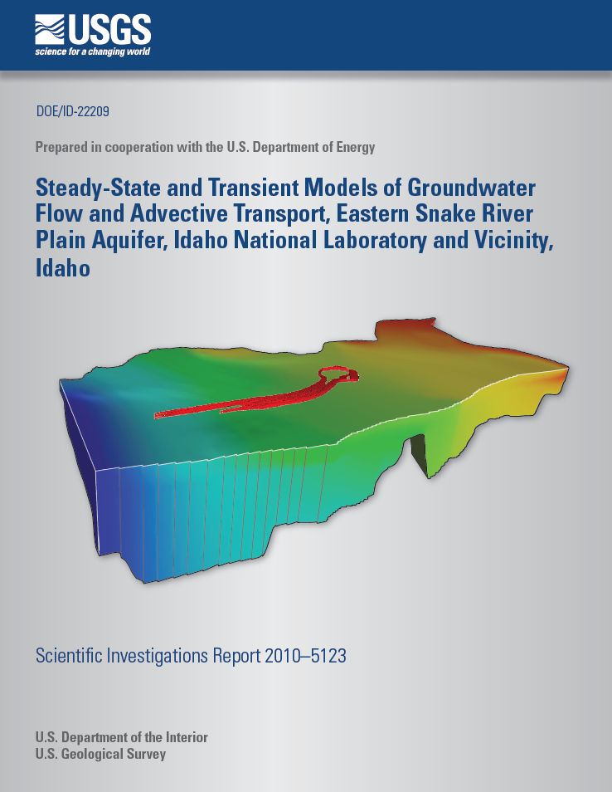
Evaluate the model to determine if model-derived estimates of groundwater movement are consistent with:
Results from previous studies of water chemistry
Geochemical mixing at an example well
Independently-derived estimates of the average linear velocity

Slide 3
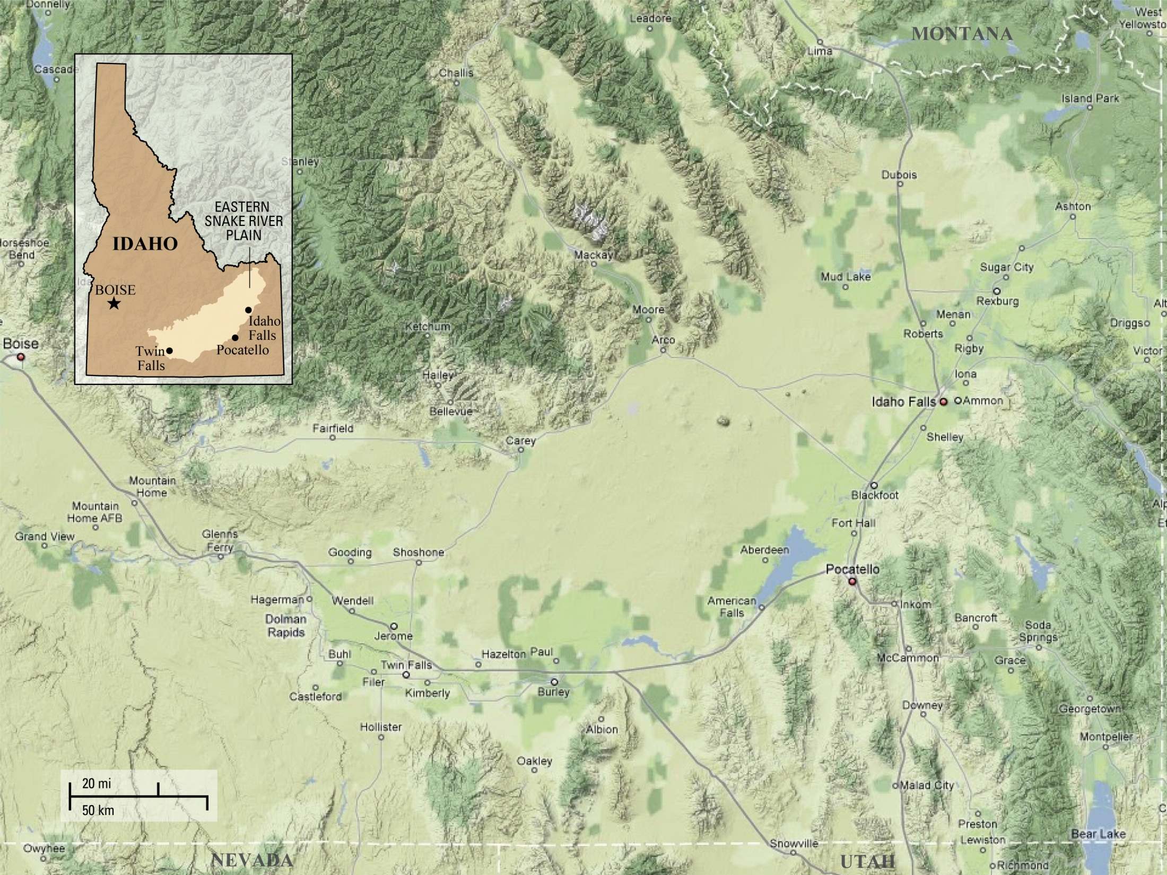
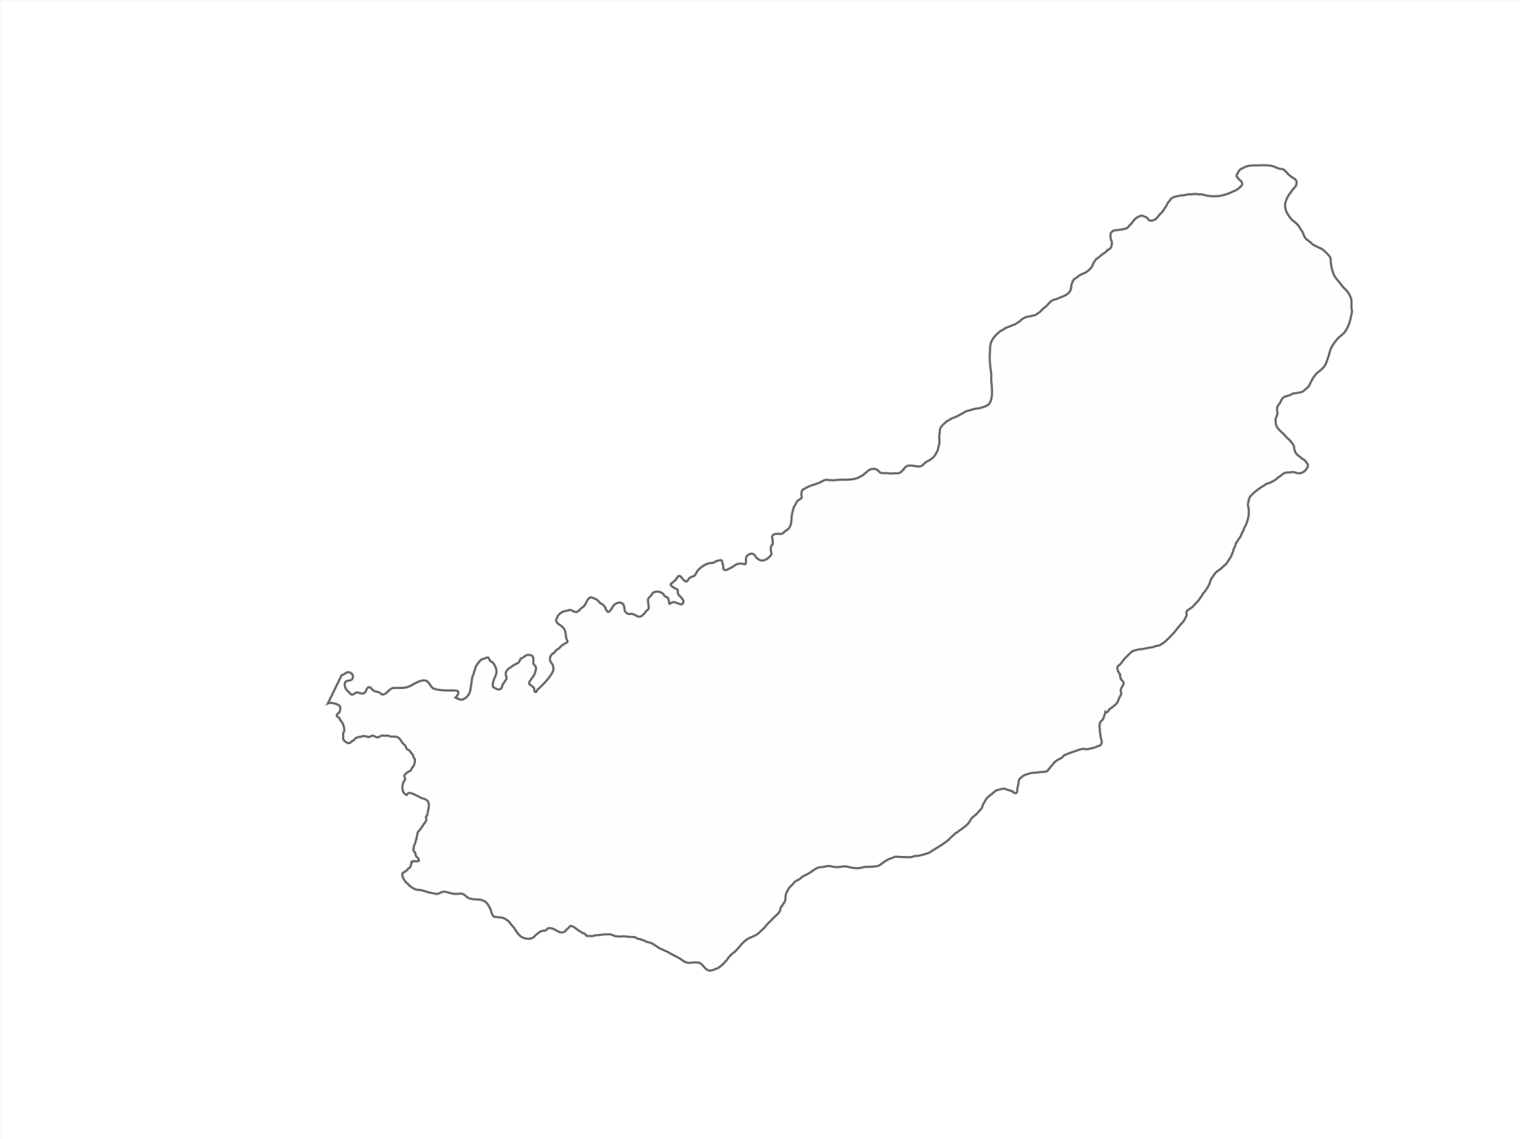
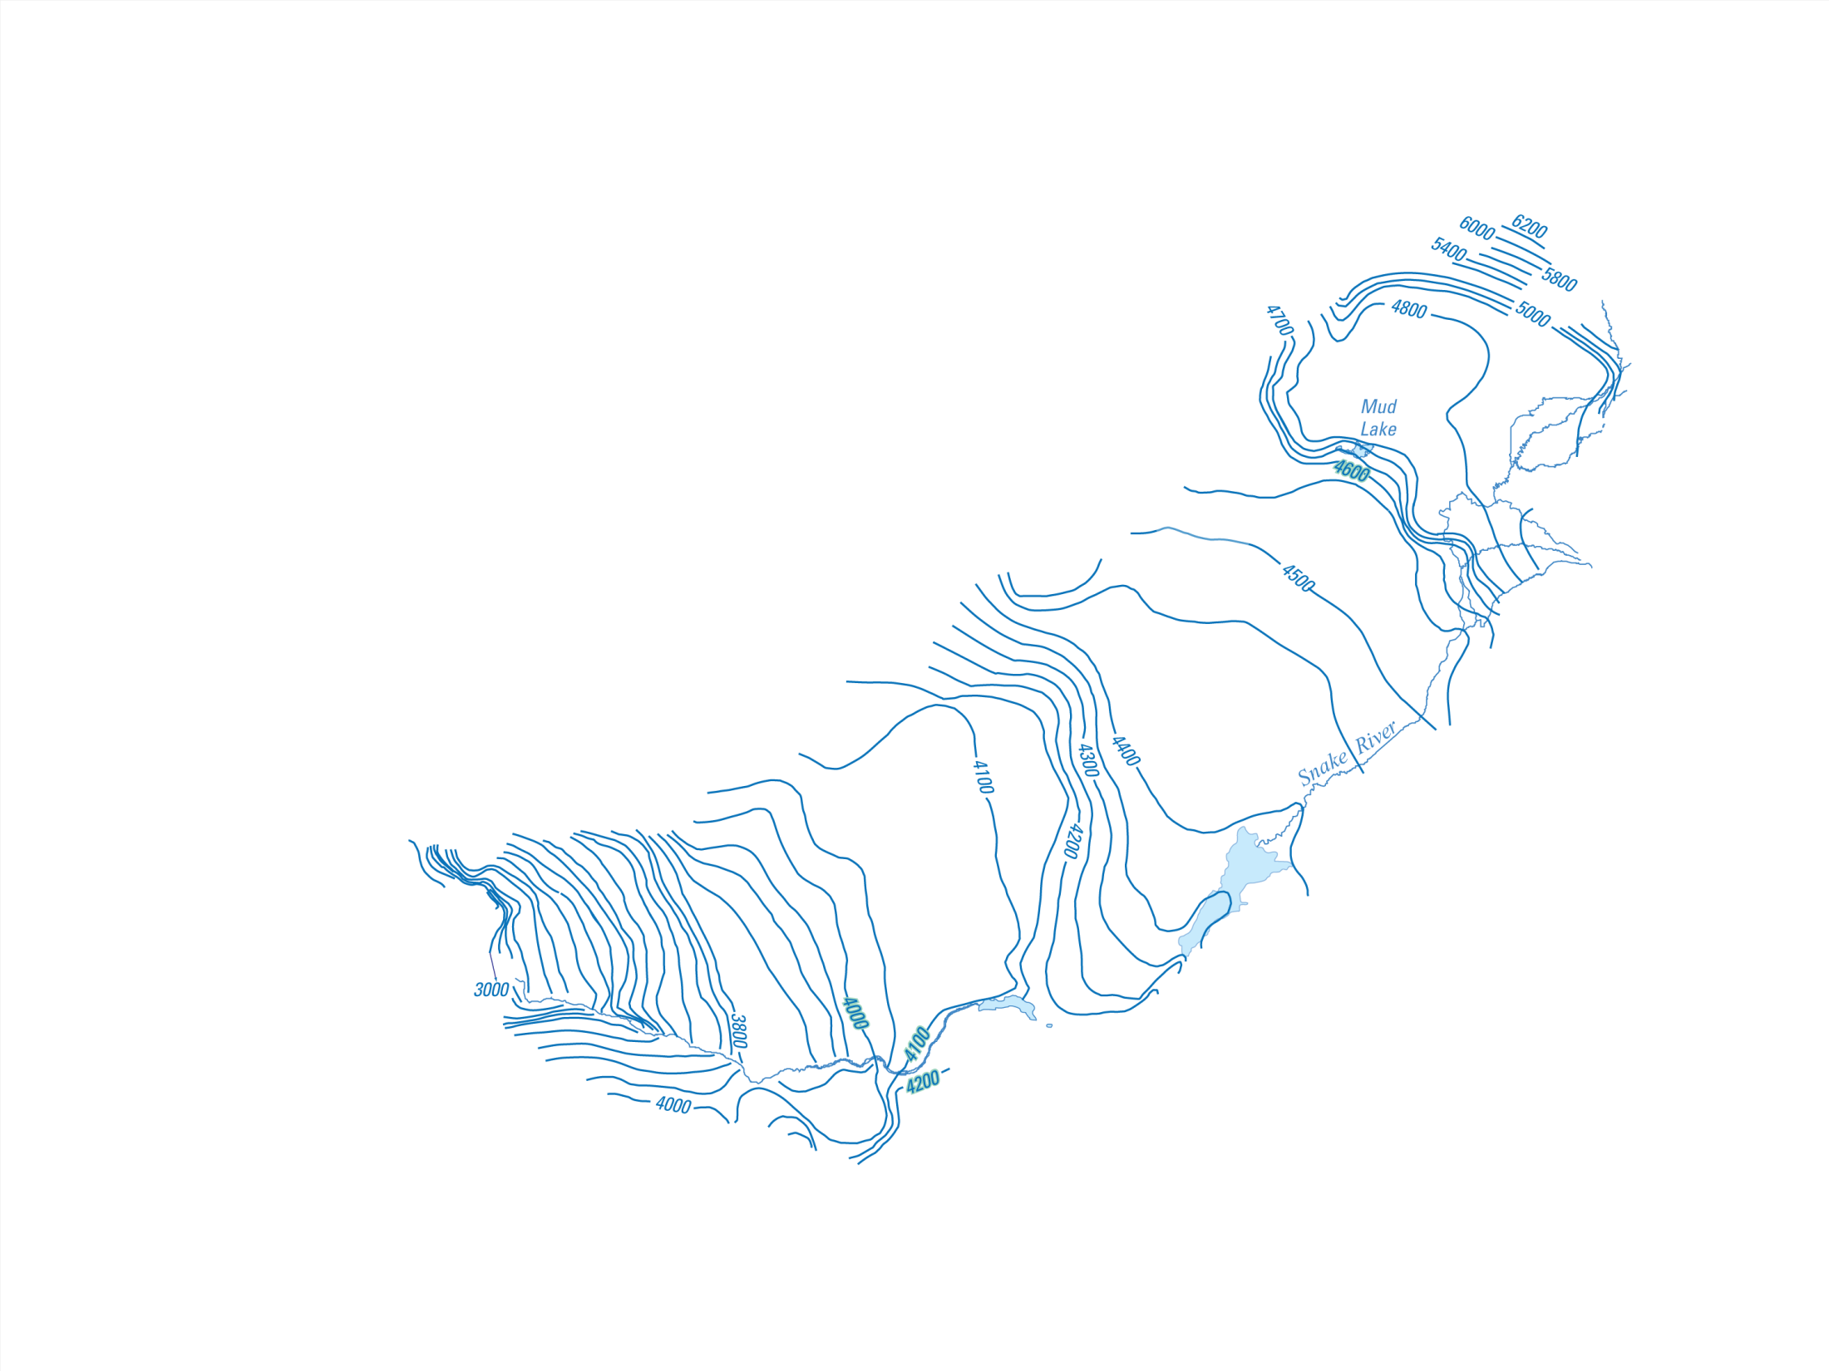
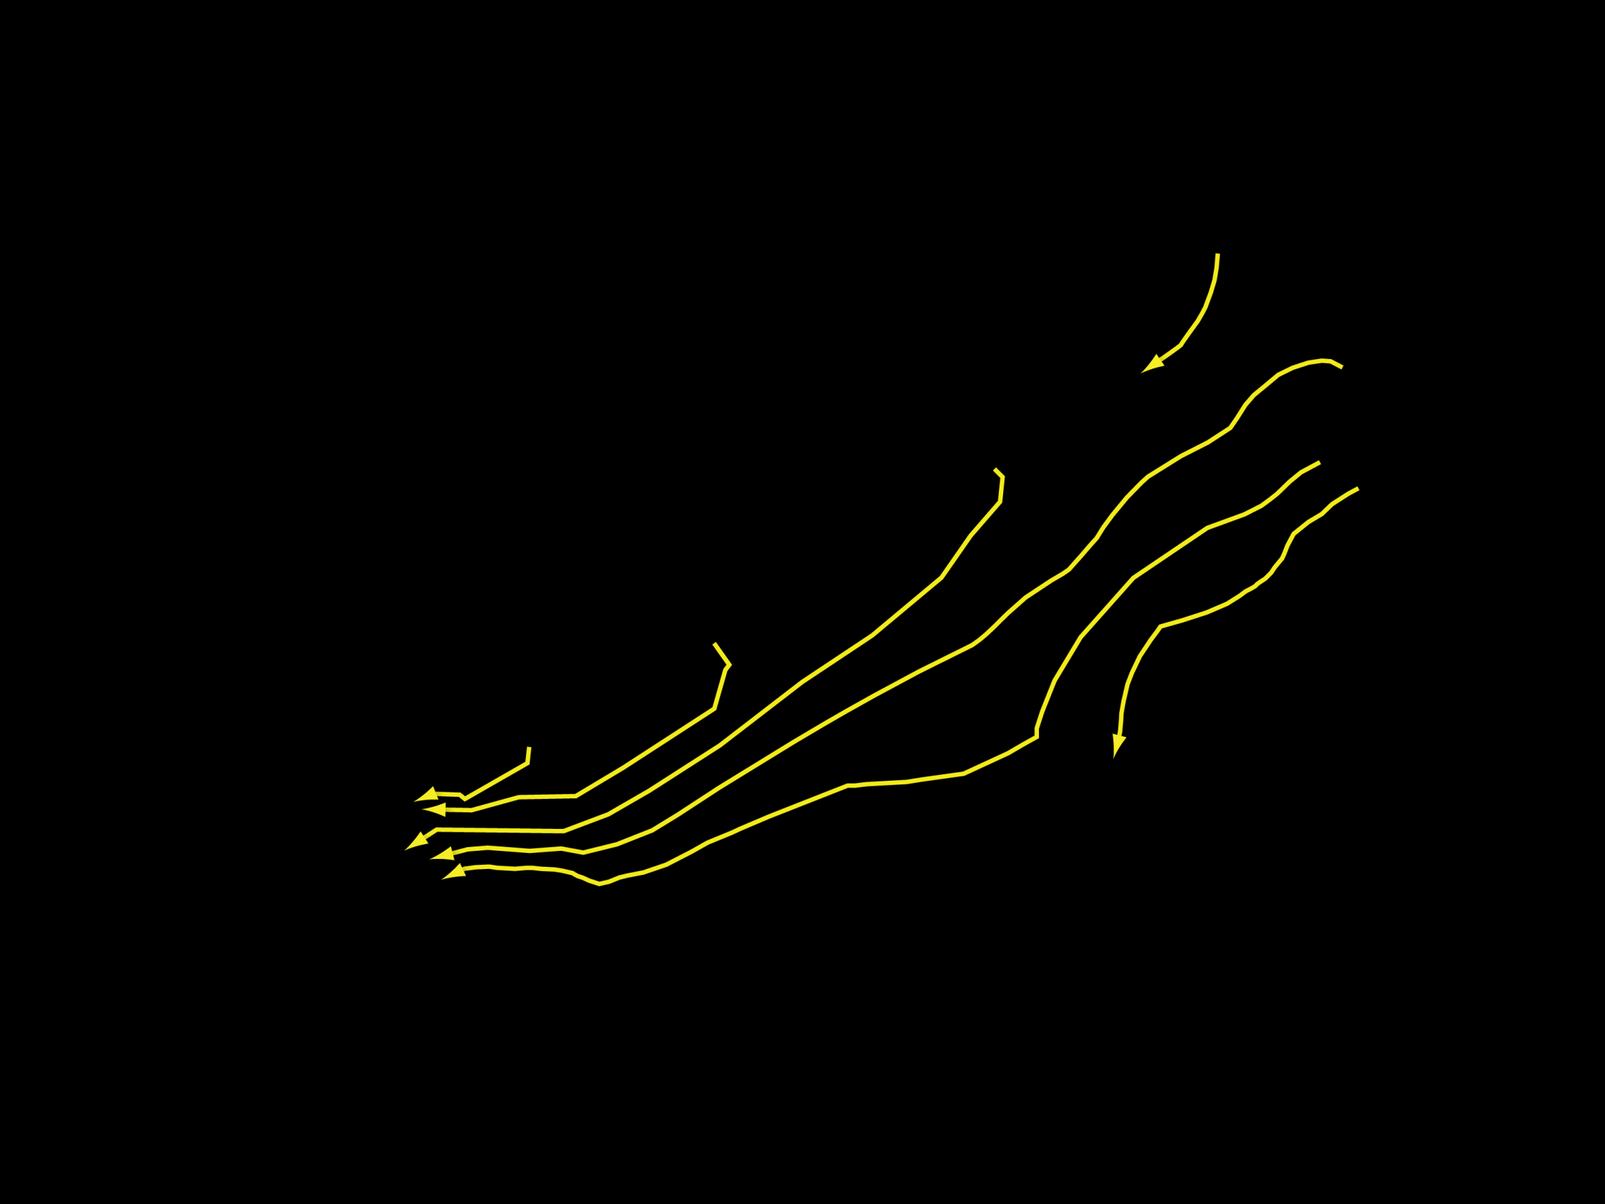

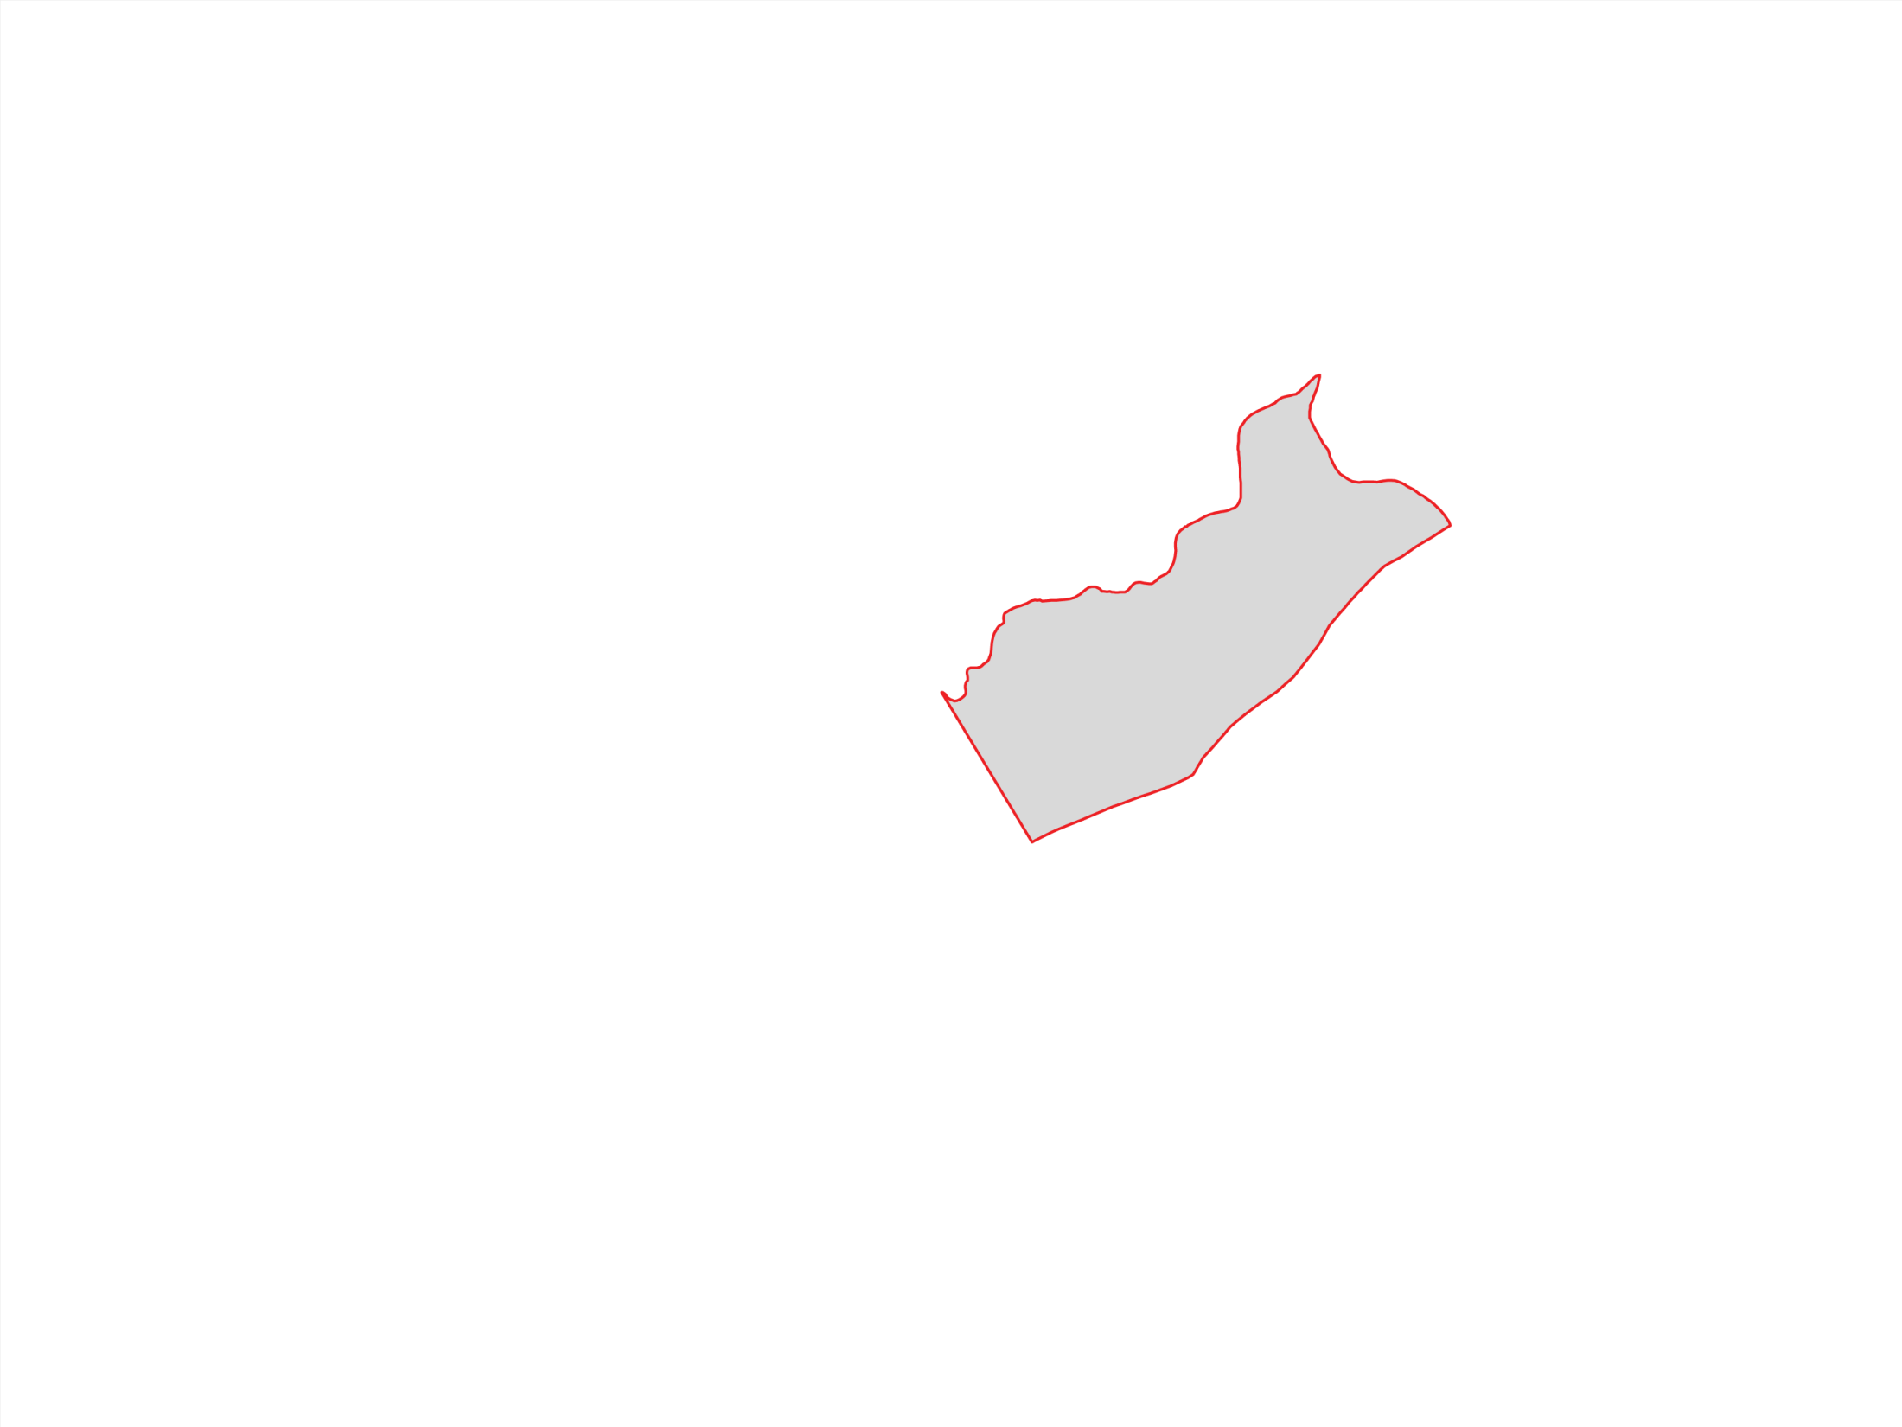
Notes:
The area of interest underlies the eastern Snake River Plain (ESRP), about 200-miles long and 50- to 70-miles wide. The plane is surrounded by mountains on three sides and rimmed by the Snake River near the edges of its eastern and southern boundaries and by canyons along its southwestern boundary.
The 1980 water-table indicate a southwest regional flow direction.
A 50-plus year history of waste disposal at the Idaho National Laboratory (INL) has resulted in measurable concentrations of contaminants in the aquifer.
Groundwater flow and contaminant transport in the aquifer were simulated by Ackerman and others (2010) at the sub-regional scale and encompasses most of the aquifer beneath the INL.
A total water-level drop of approximately 3200 ft.

Slide 4
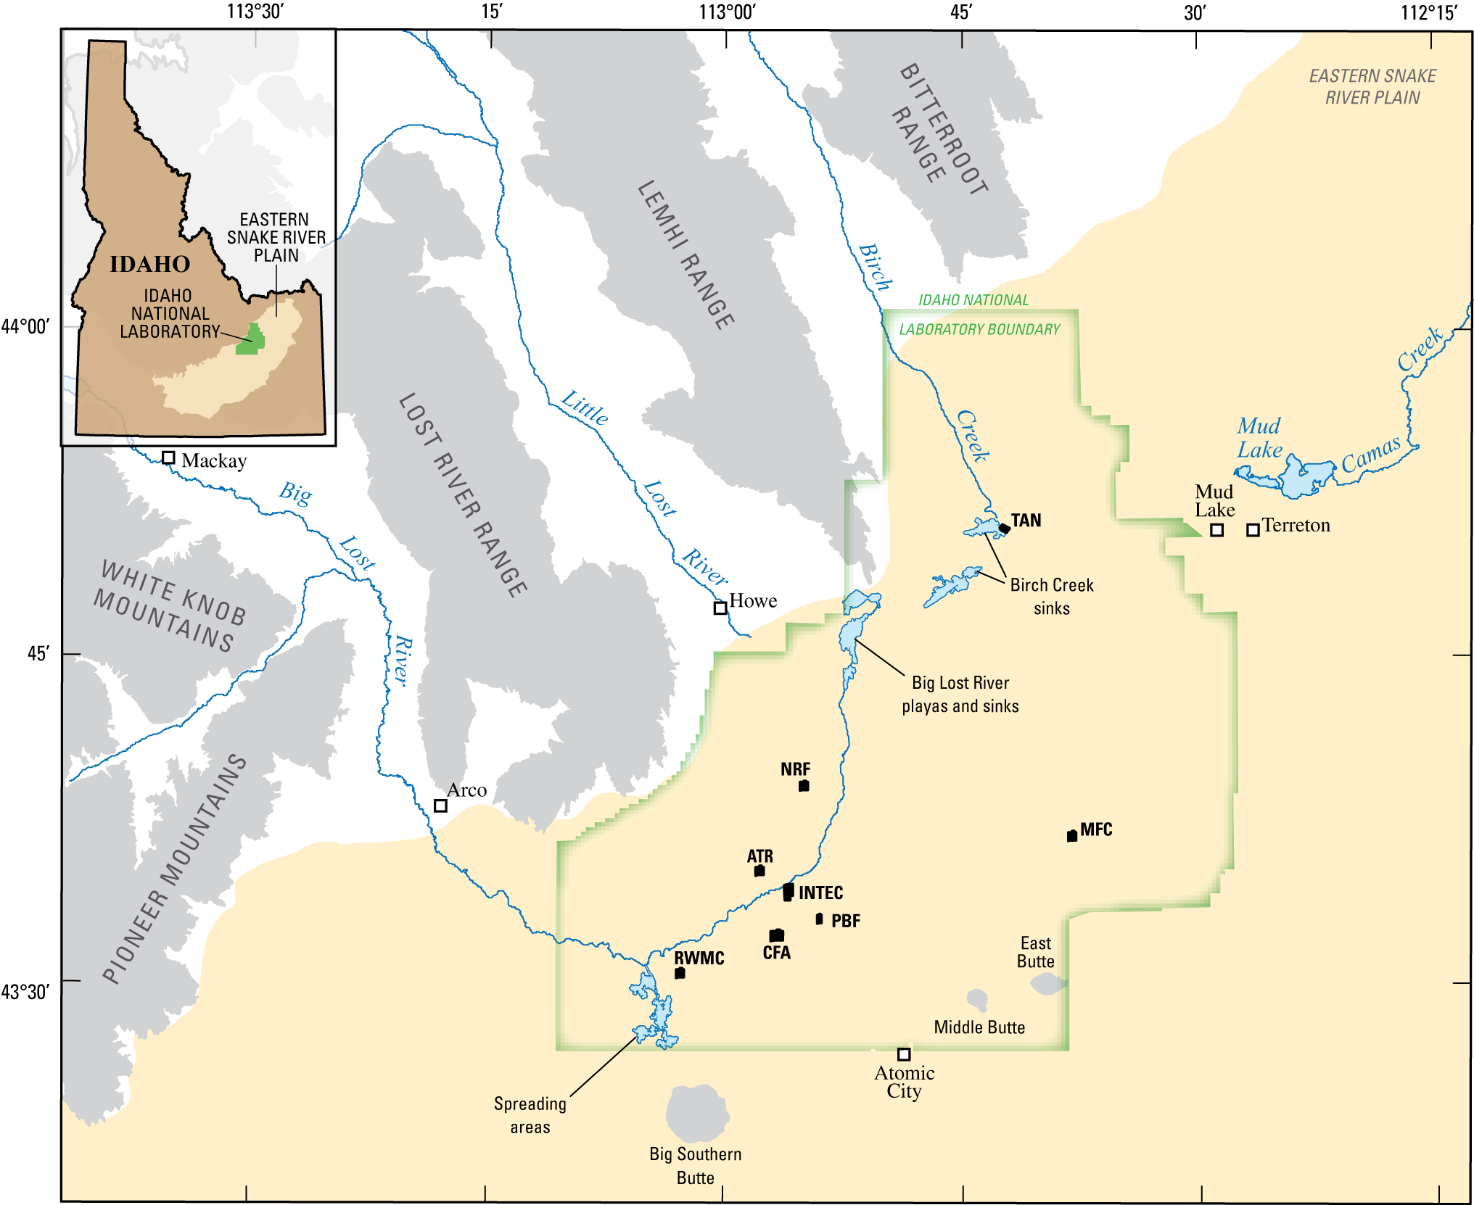
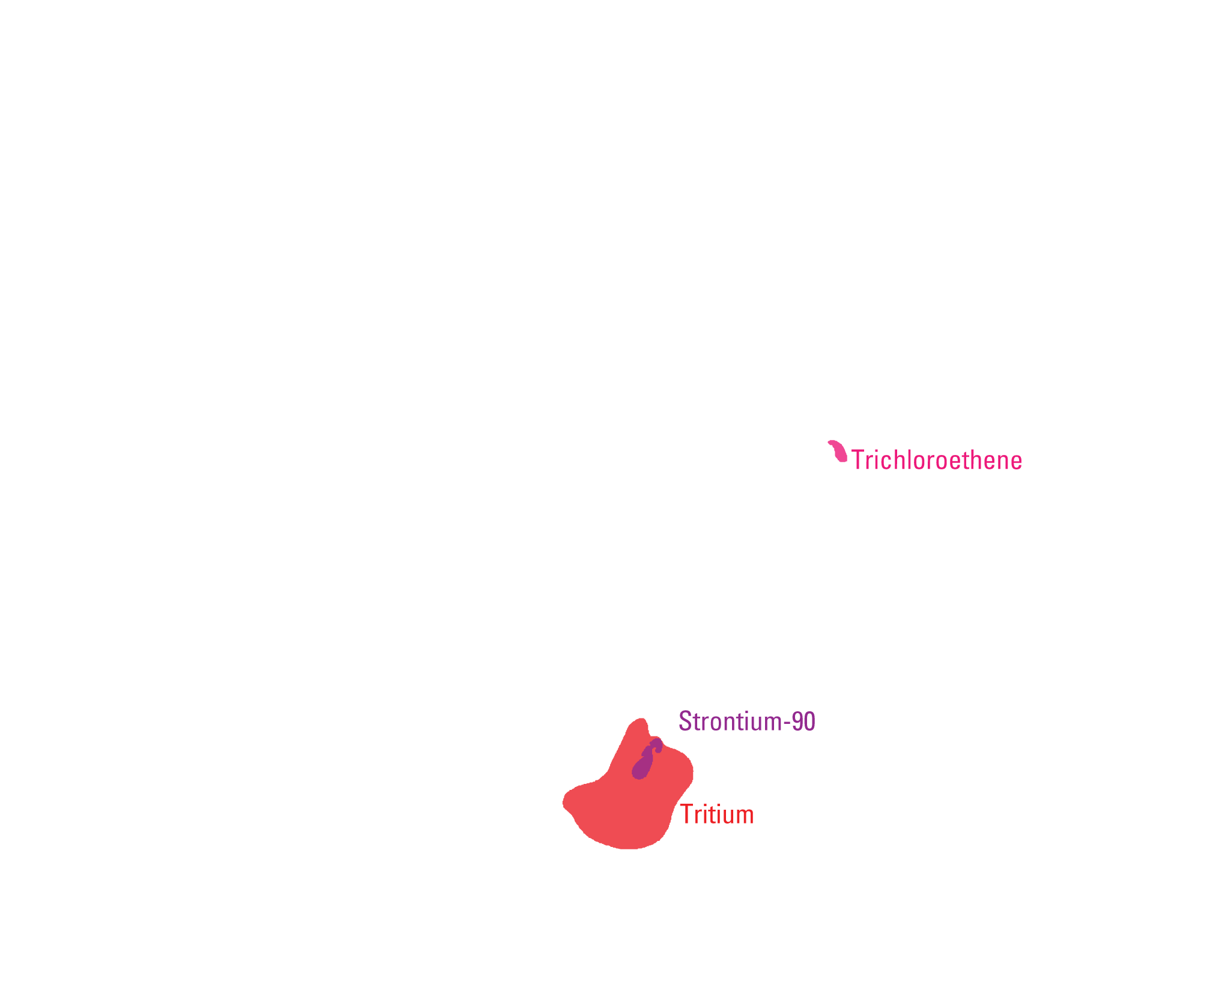
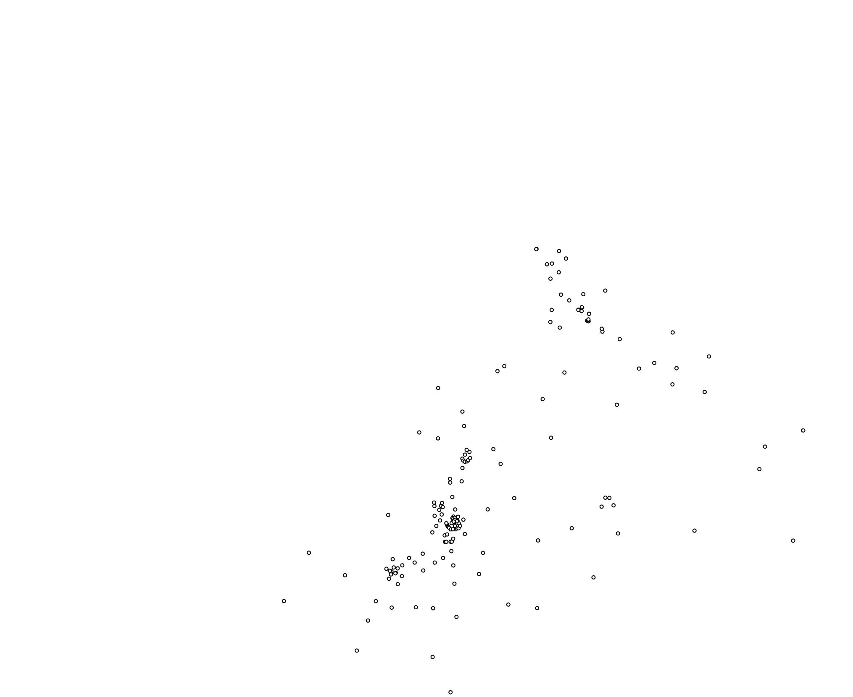
Notes:
The study site is located in the west-central part of the plain and within the boundaries of the Idaho National Laboratory (INL). The INL was established in 1949 to build, operate, and test nuclear reactors. A 50-plus year history of waste disposal at the INL has resulted in measurable concentrations of contaminants in the aquifer beneath the INL. The principal sources of contaminants are wastewater-disposal sites at Test Area North (TAN), the Naval Reactors Facility (NRF), the Advanced Test Reactor complex (ATR), and the Idaho Nuclear Technology and Engineering Center (INTEC).
Contaminants include trichloroethene, stronntium-90, and tritium; as well as, chlorine-36 and iodine-129 which have been detected in monitoring wells downgradient of ATR and INTEC. Note that little data is available to characterize the true areal extent and shape of these plumes. Also, it’s difficult to determine the long-term risks associated with contaminants that are present in the aquifer today or might be present in the future because of slow releases of residual contamination present in the unsaturated zone.
For more than fifty years a network of monitoring wells has recorded water-level and water-quality observations in over 200 boreholes with variable lengths of record. Most boreholes penetrate only the upper portion of the aquifer and are completed as open holes; therefore, little data is available to describe the vertical distribution of contaminants within the aquifer.
Starting in 2005, multilevel monitoring systems were installed in six boreholes within the INL to provide the necessary means to better characterize the vertical movement of water and contaminants in the aquifer. These boreholes include USGS 103, 132, 133, 134, MIDDLE 2050A, and 2051.

Slide 5
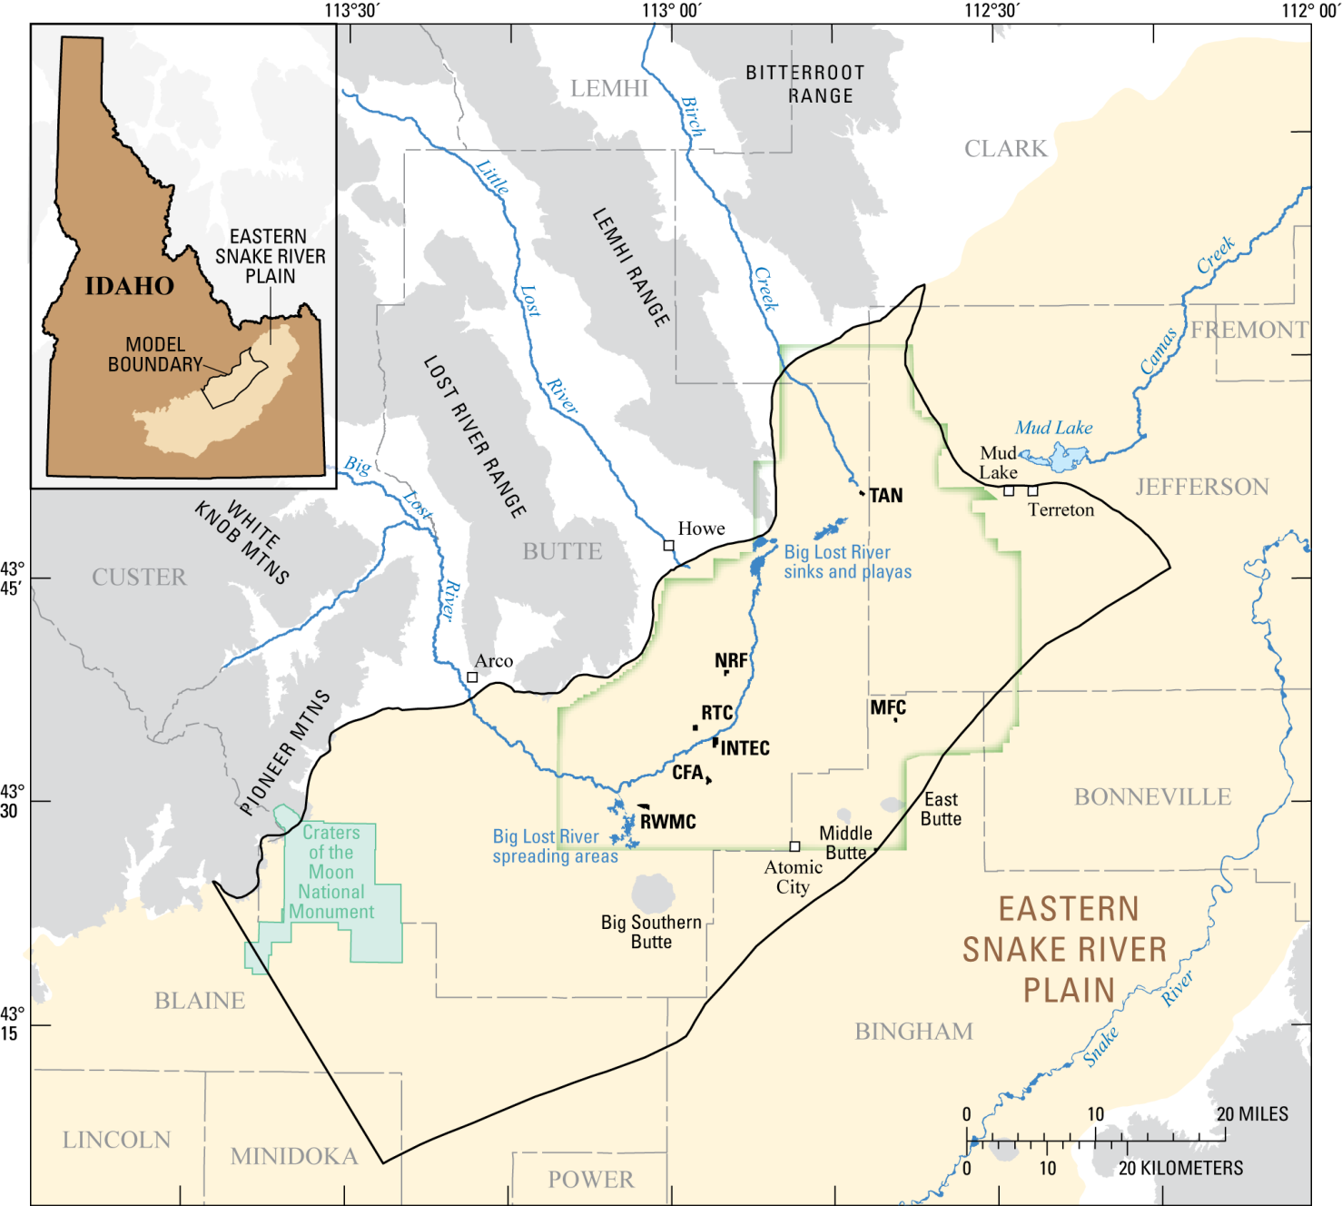
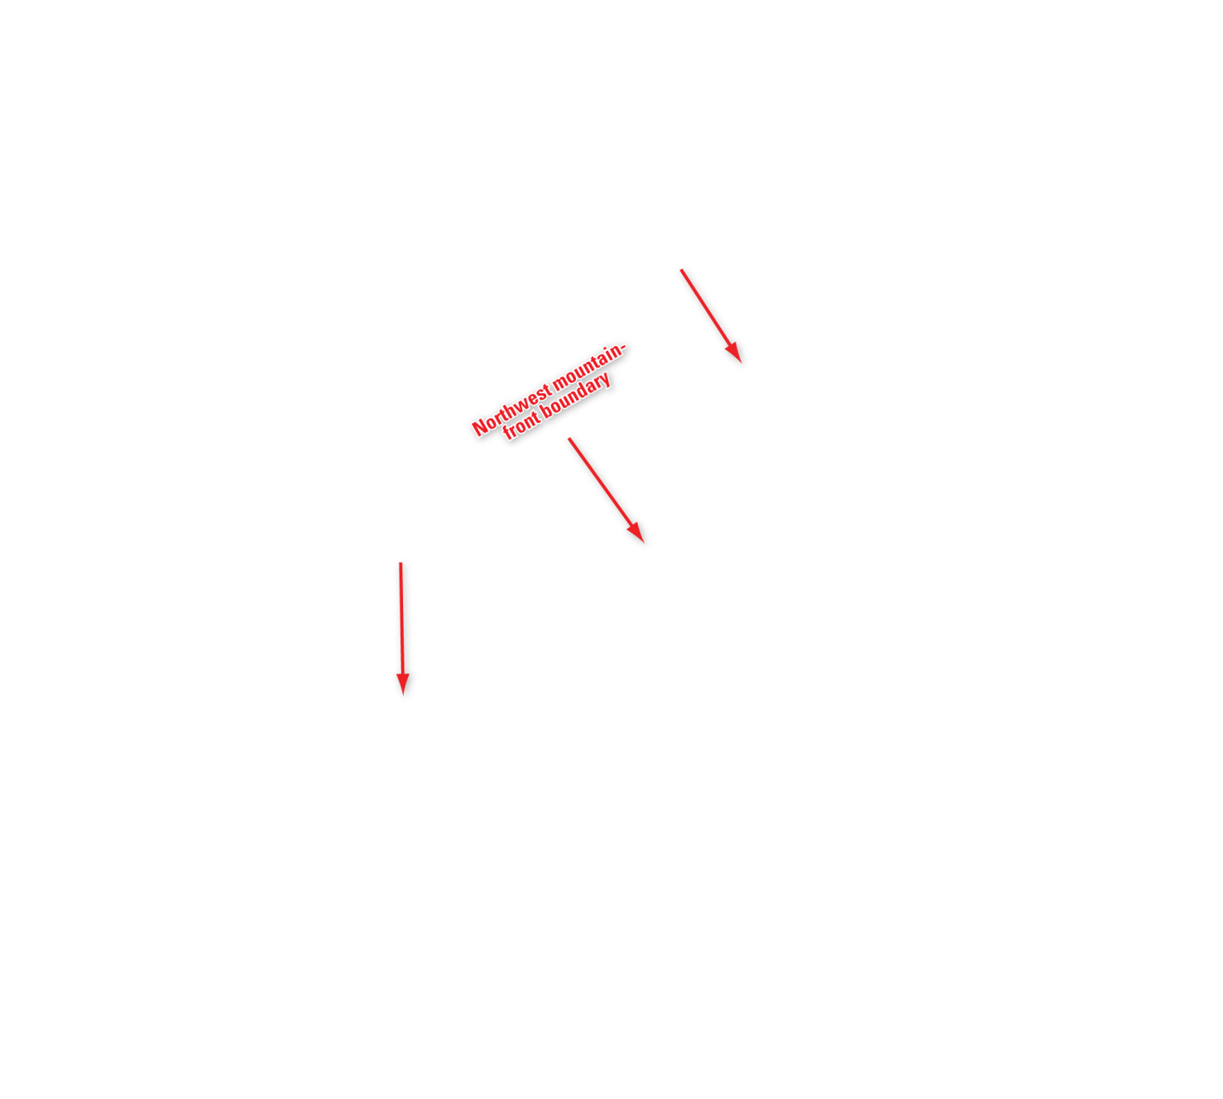



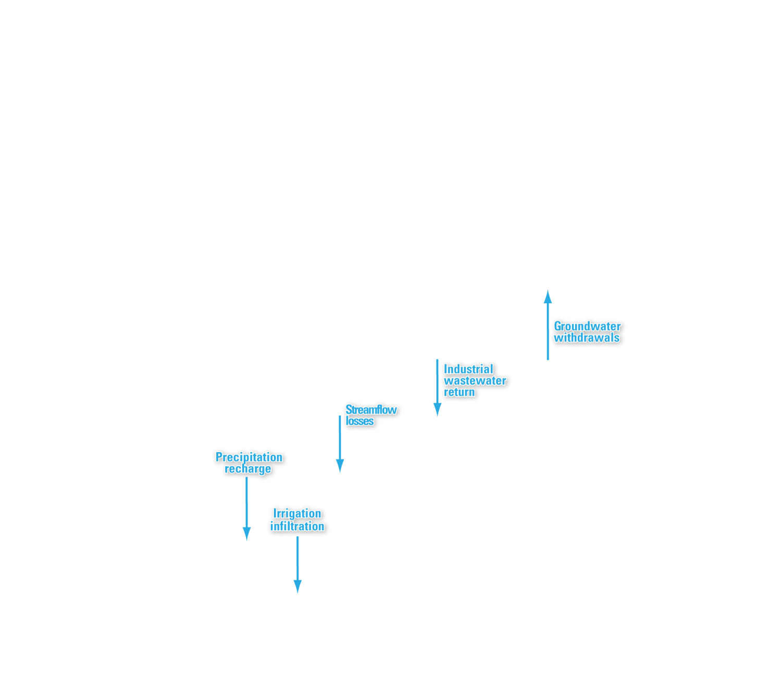

Notes:
Fluxes across the boundaries of the model domain include:
Tributary valley underflow entering through the northwest mountain-front boundary. The tributary valleys include the Big Lost River, Little Lost River and Birch Creek.
Regional underflow entering across the northeast boundary.
No flow across the southwest flow-line boundary.
Underflow exiting through the southwest boundary.
Surface water entering the system across the water table-boundary due to precipitation recharge, irrigation infiltration, and industrial wastewater return; with groundwater withdrawals from pumping wells accounting for an internal loss of water from the system.
Flow across the base of the aquifer was assumed negligible.

Slide 6
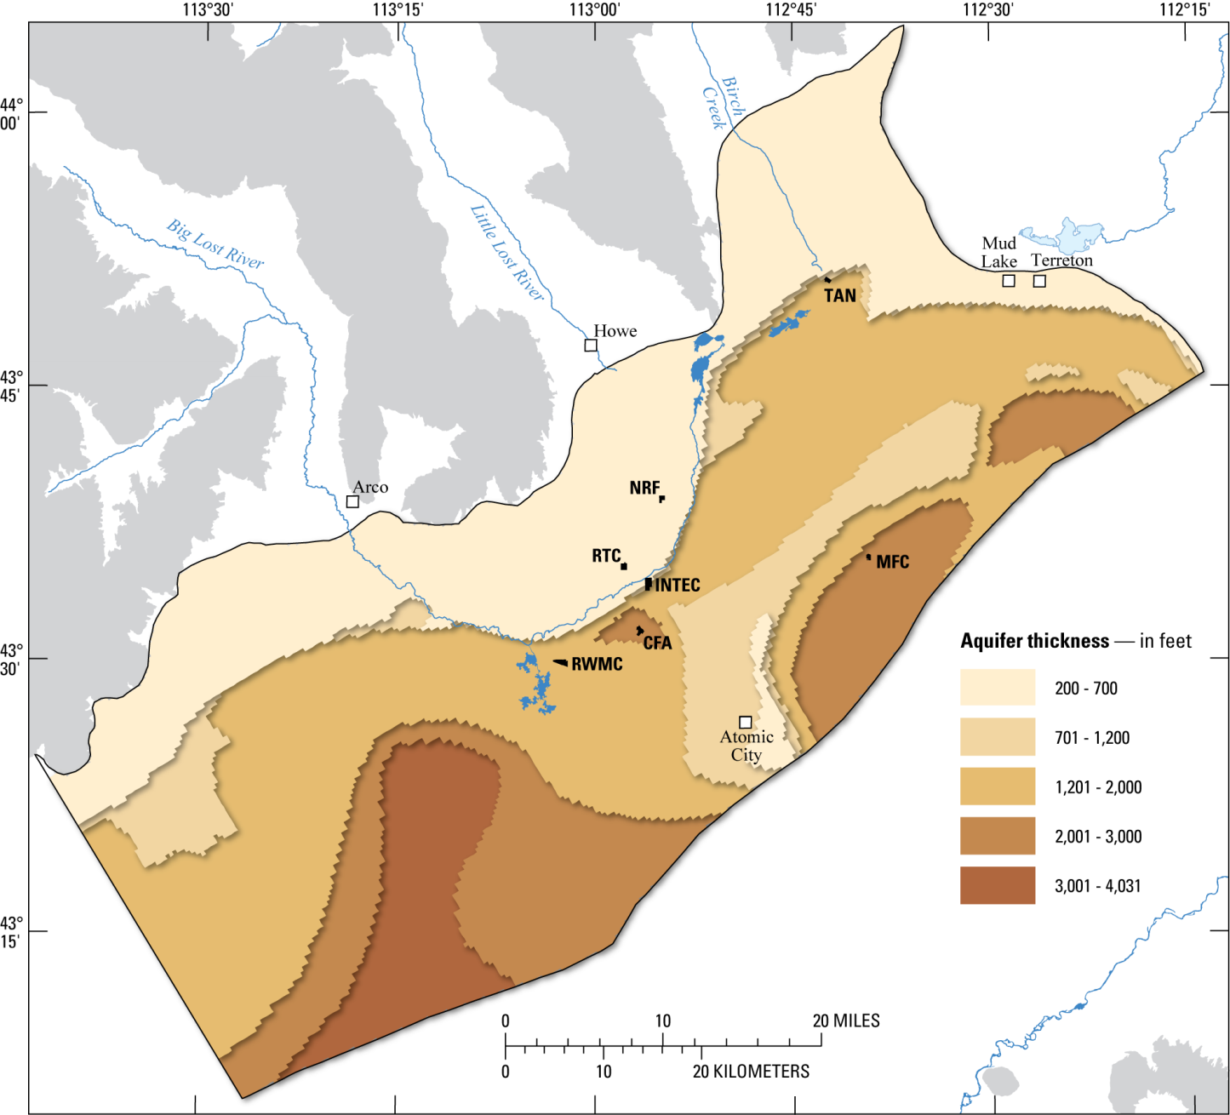
Notes:
The thickness of the aquifer estimated from land-surface electrical-resistivity surveys and the few boreholes that penetrate to bedrock is shown here; and is at least 1,200 feet thick and may be 4,000 feet thick in the southern portion of the model domain.

Slide 7
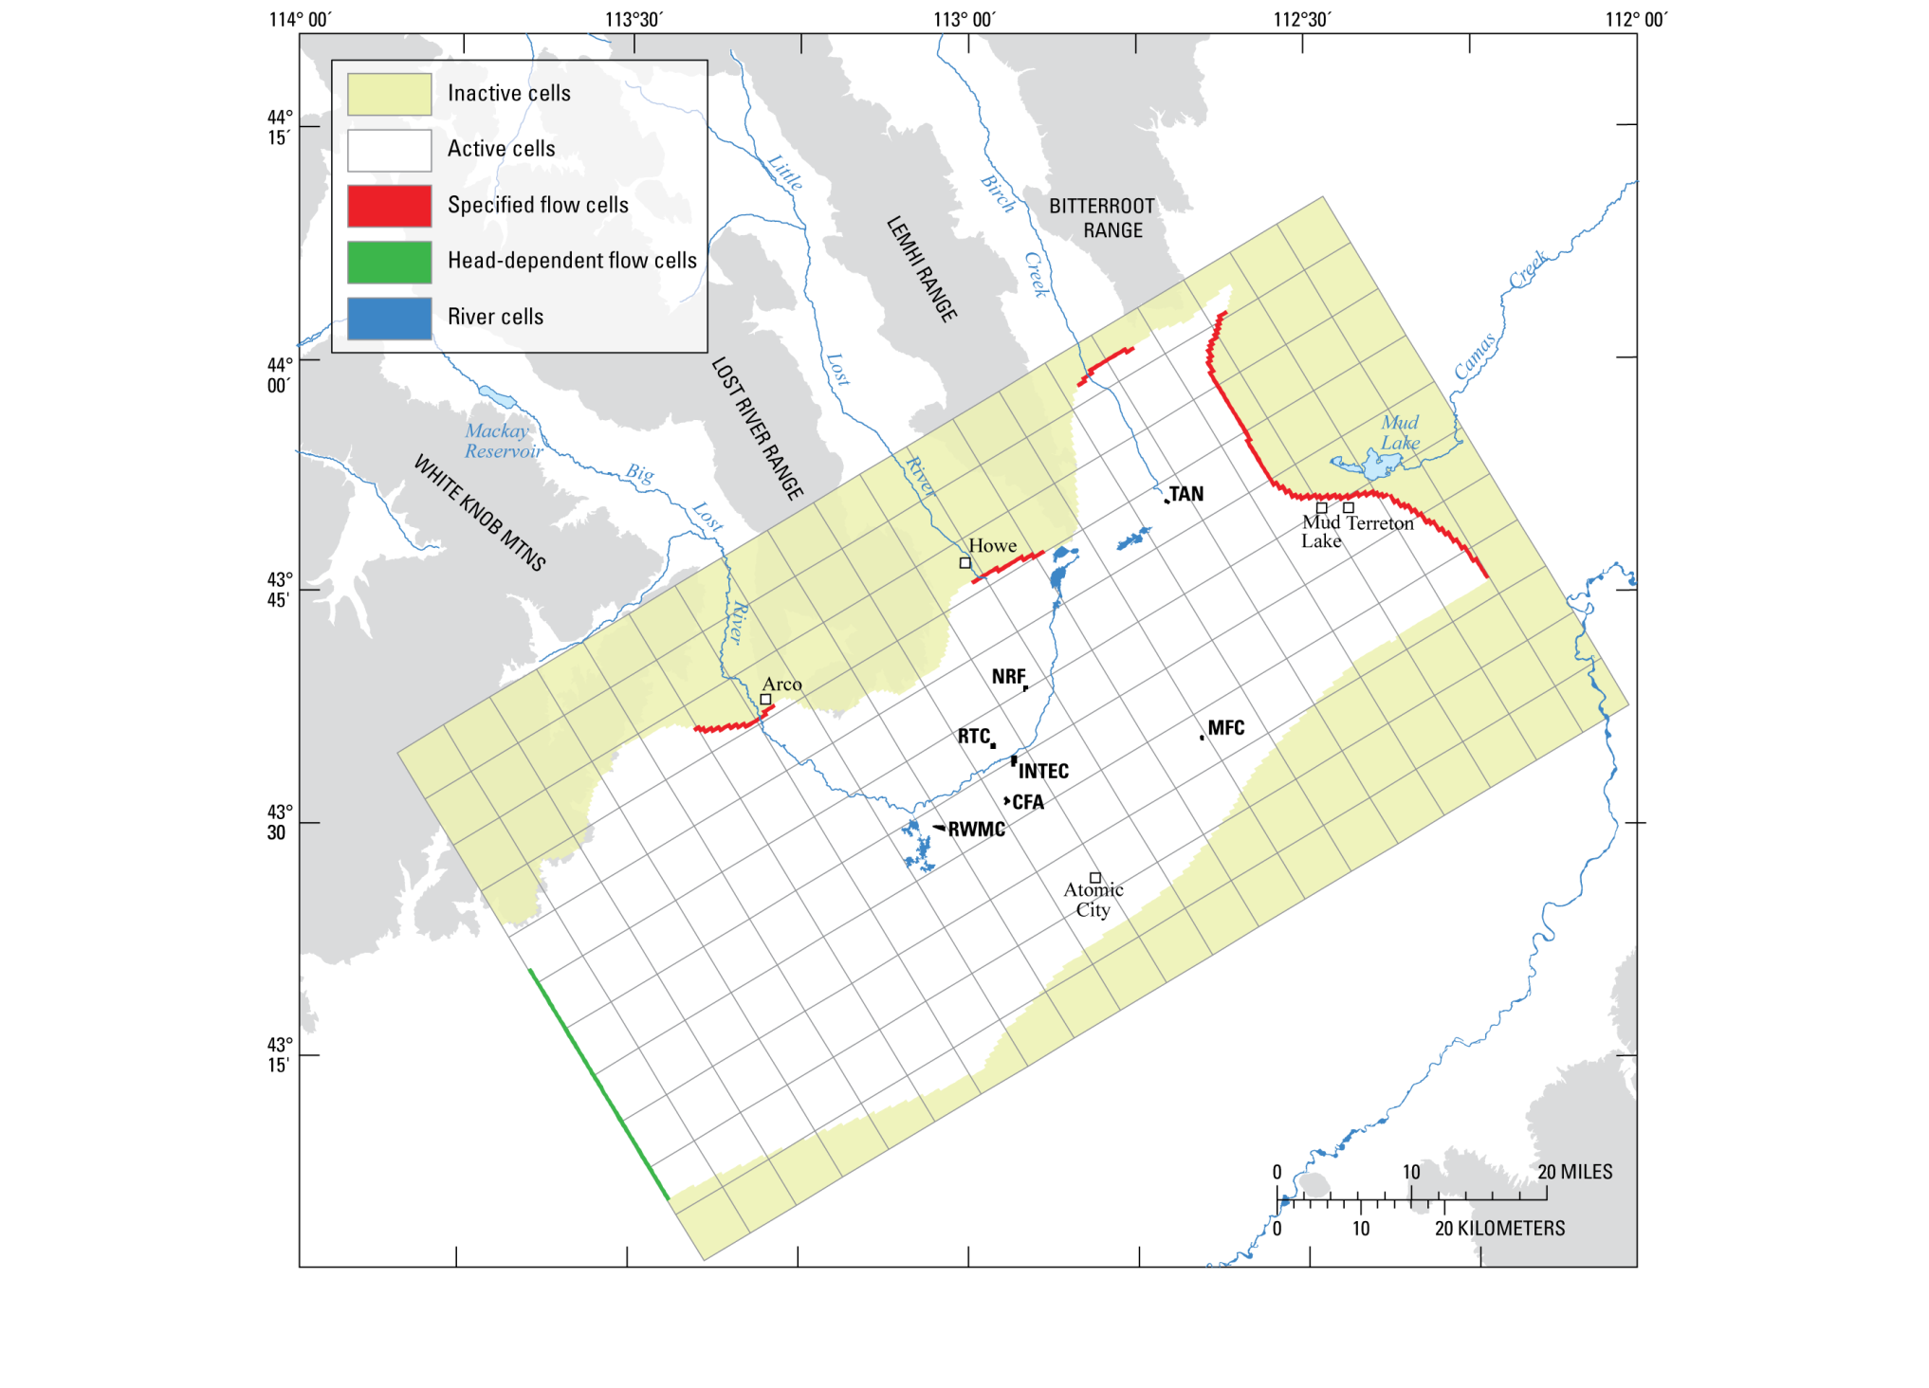
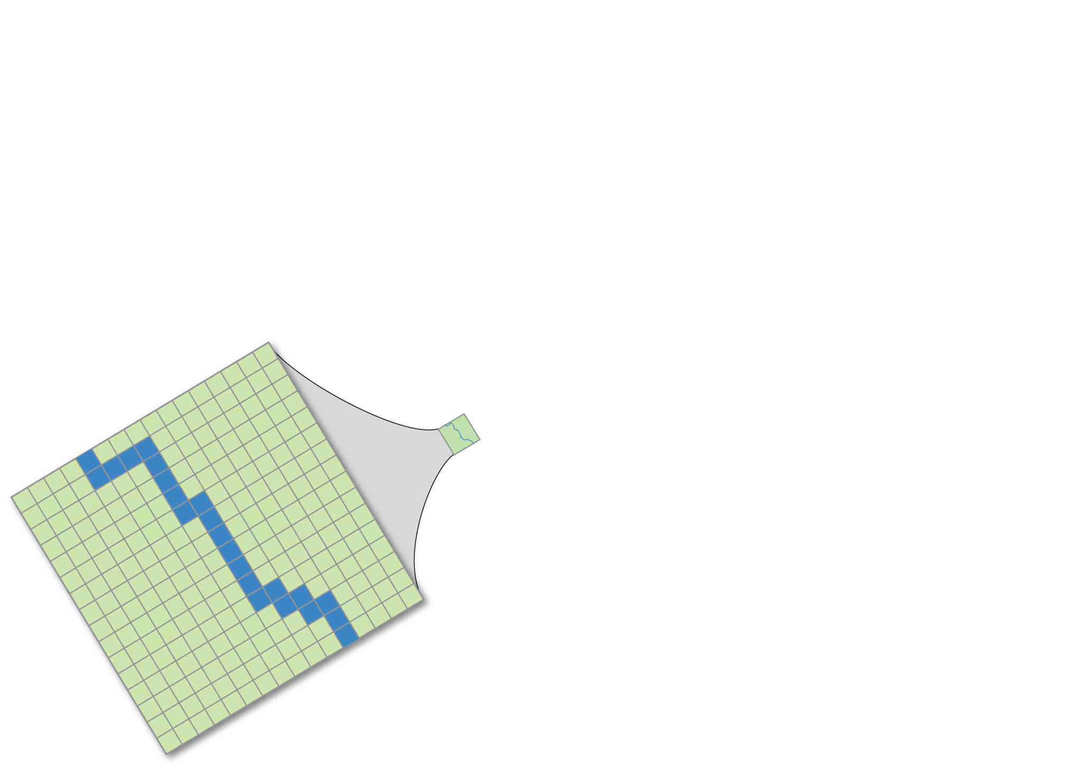


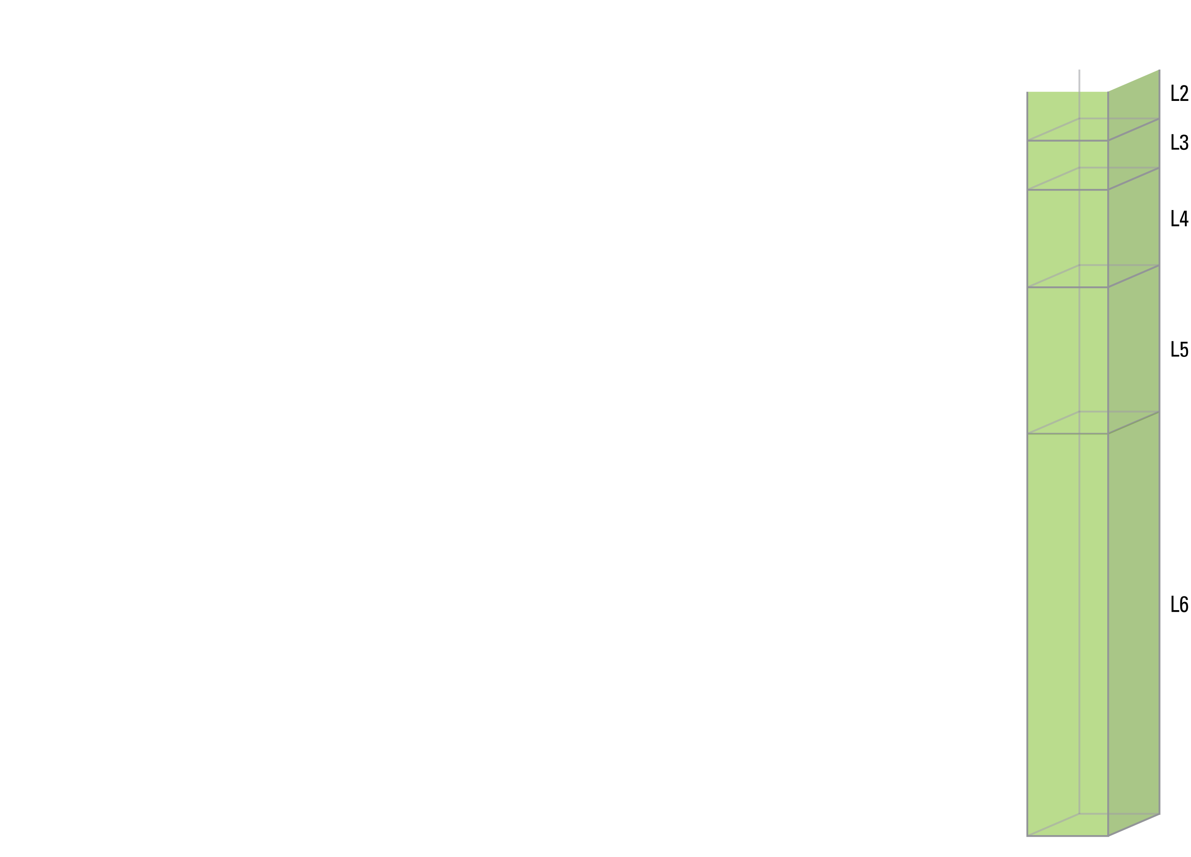
Notes:
Steady-state groundwater flow conditions were simulated using MODFLOW 2000, a USGS three-dimensional finite-difference model. Active and inactive cells are used to define the models spatial domain.
Boundary conditions include specified flow cells along the northwest mountain front boundary and northeast regional-underflow boundary, and head-dependent flow cells along the southwest boundary.
Cell size and shape are uniform within the aerial extent of the model domain with a spatial resolution of 0.25 mi².
Each cell is described using a rectangular prism with a vertical thickness that varies with depth. The finite-difference grid extends into the vertical dimension using layers of cells.

Slide 8
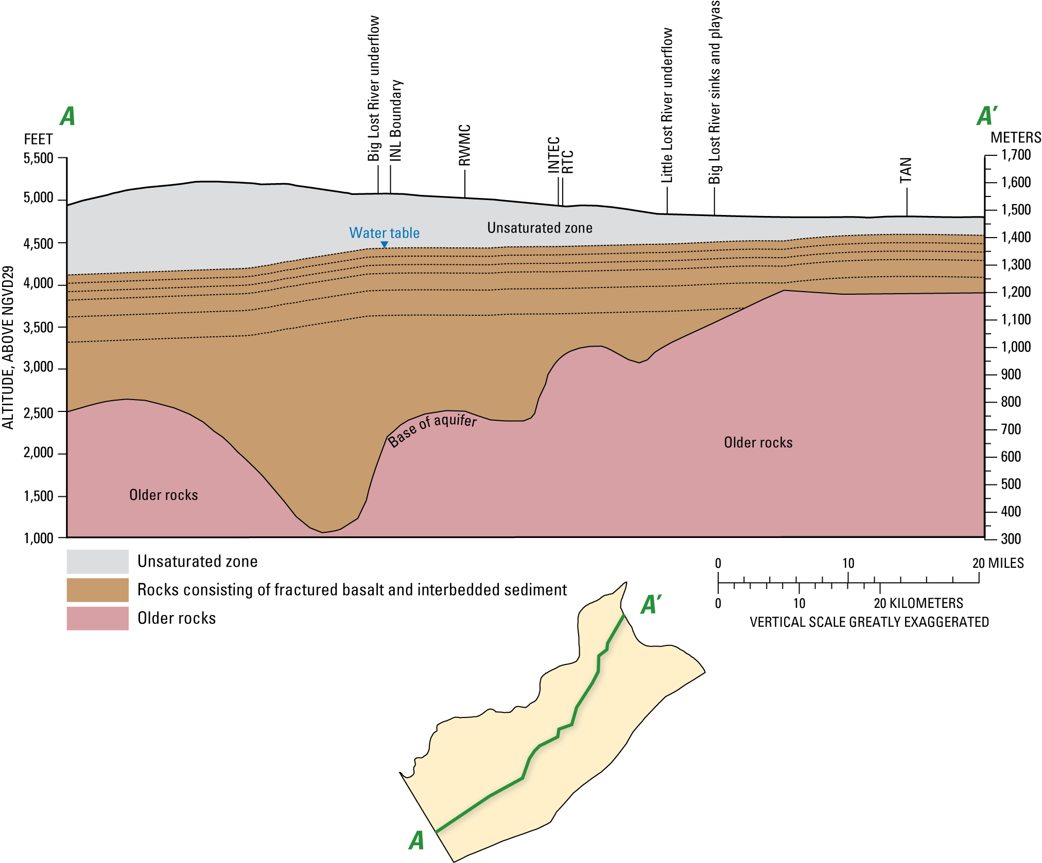
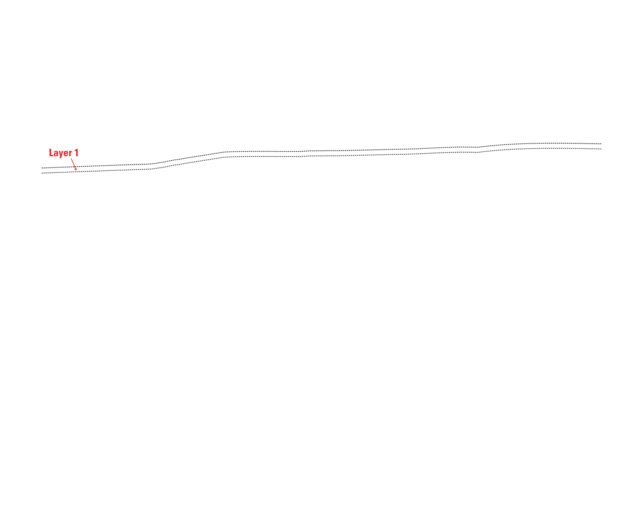
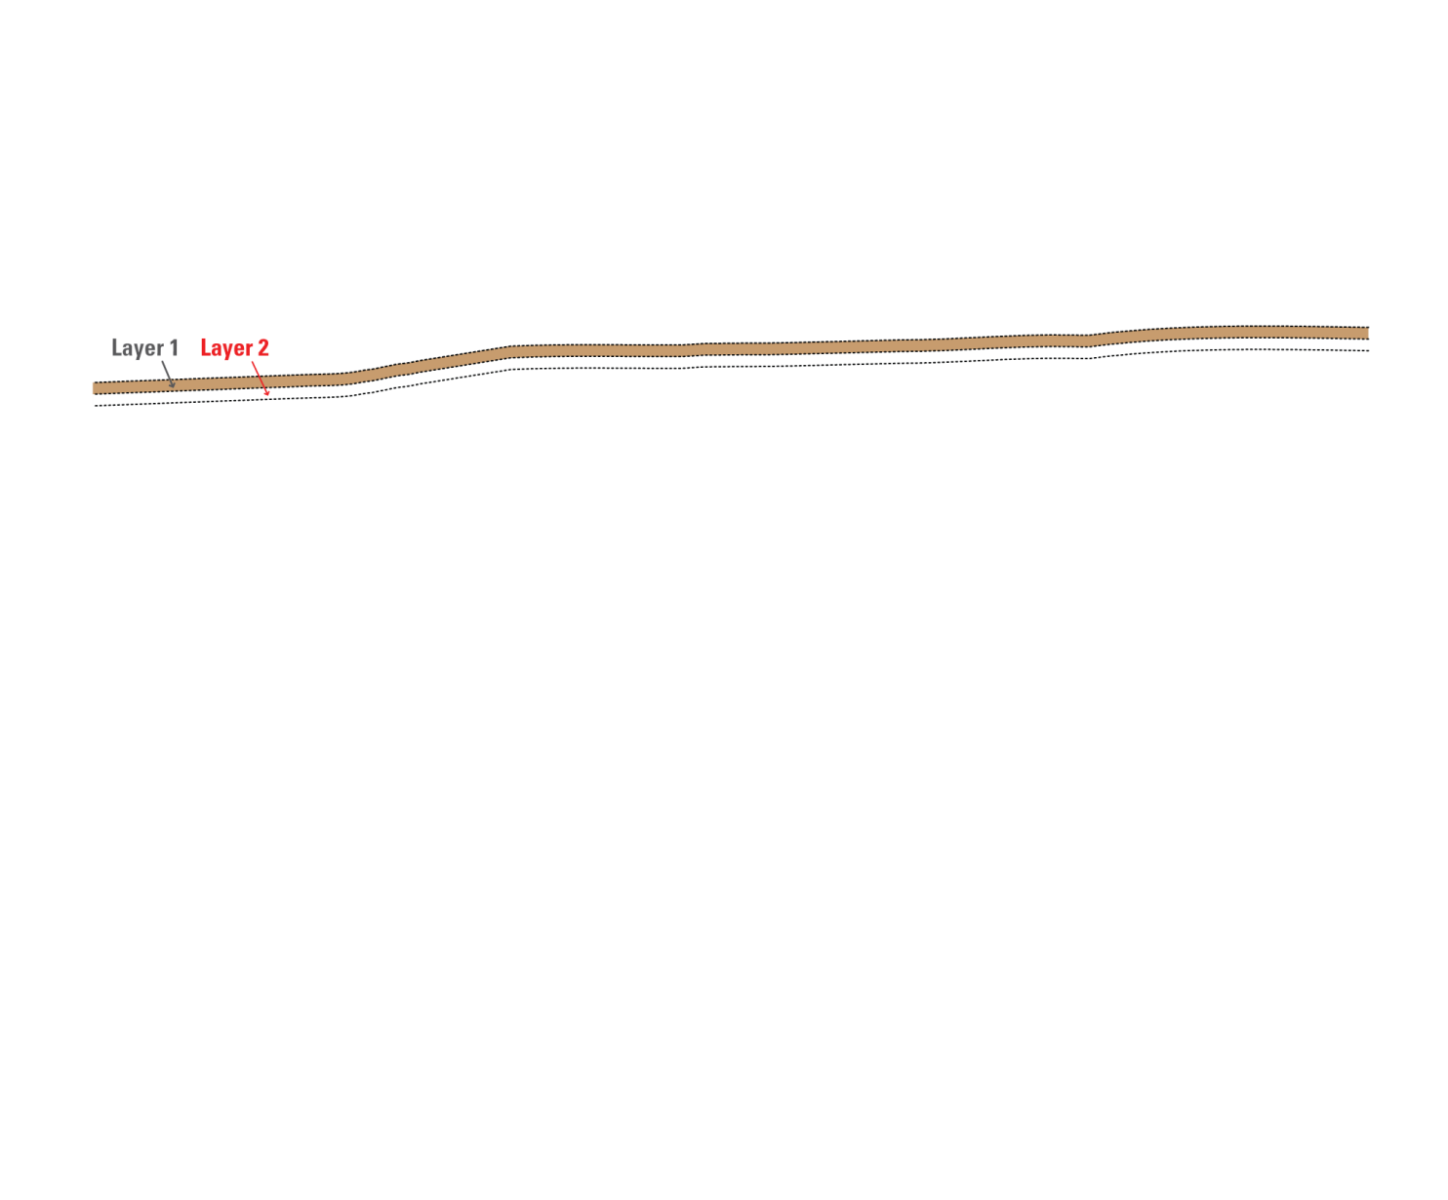
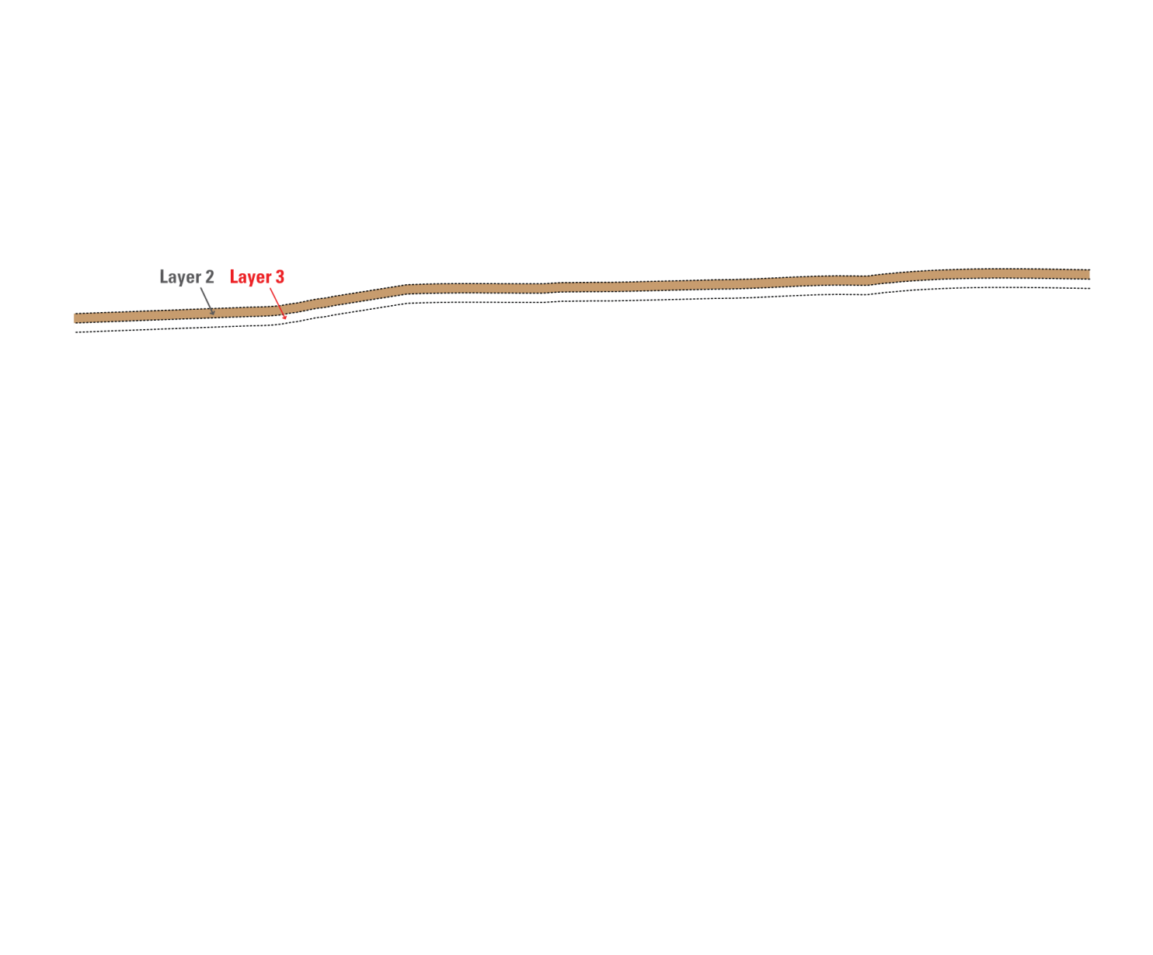
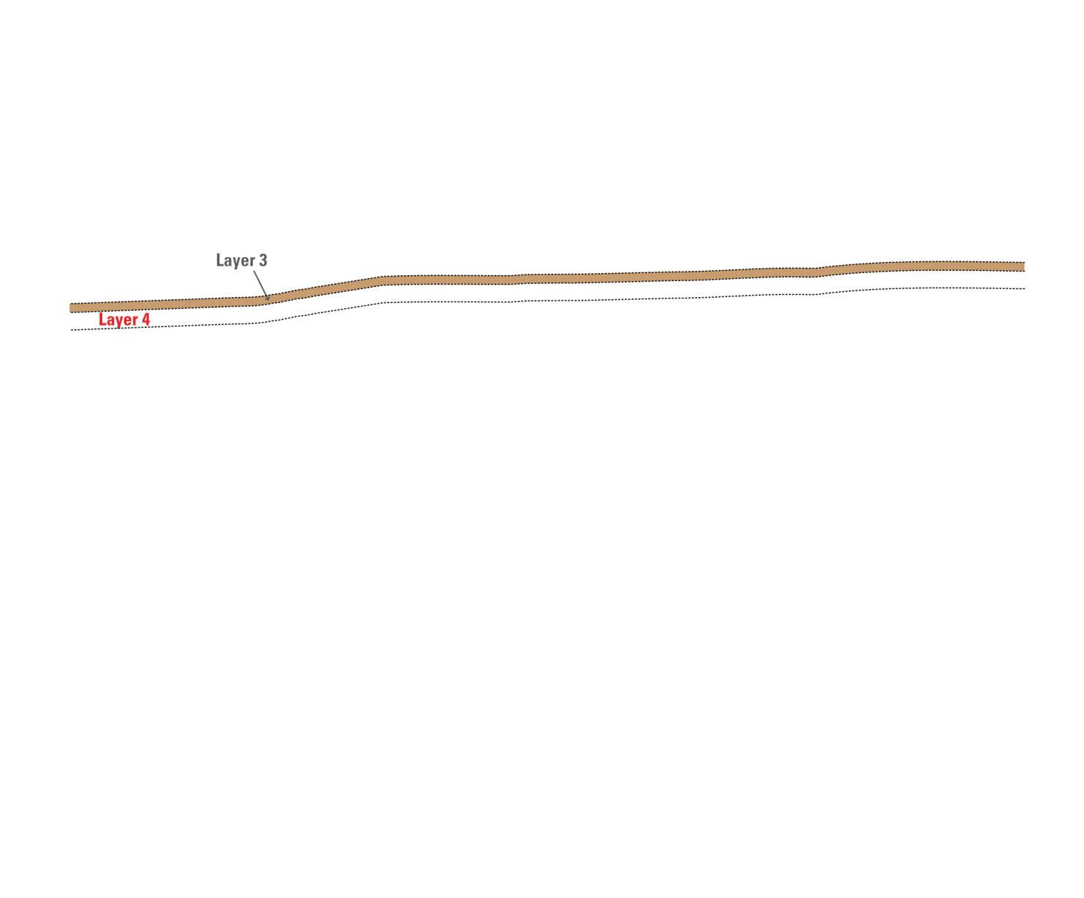
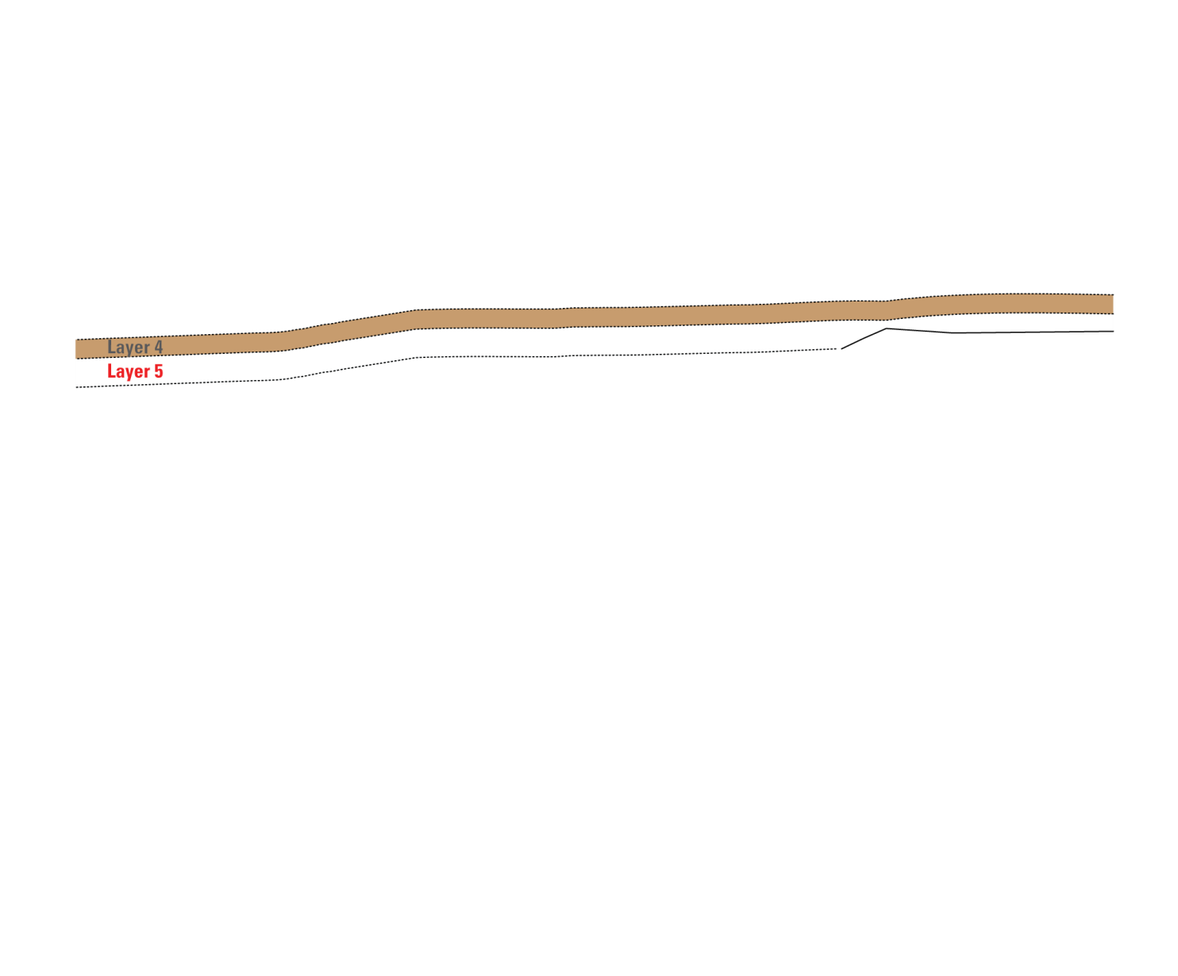
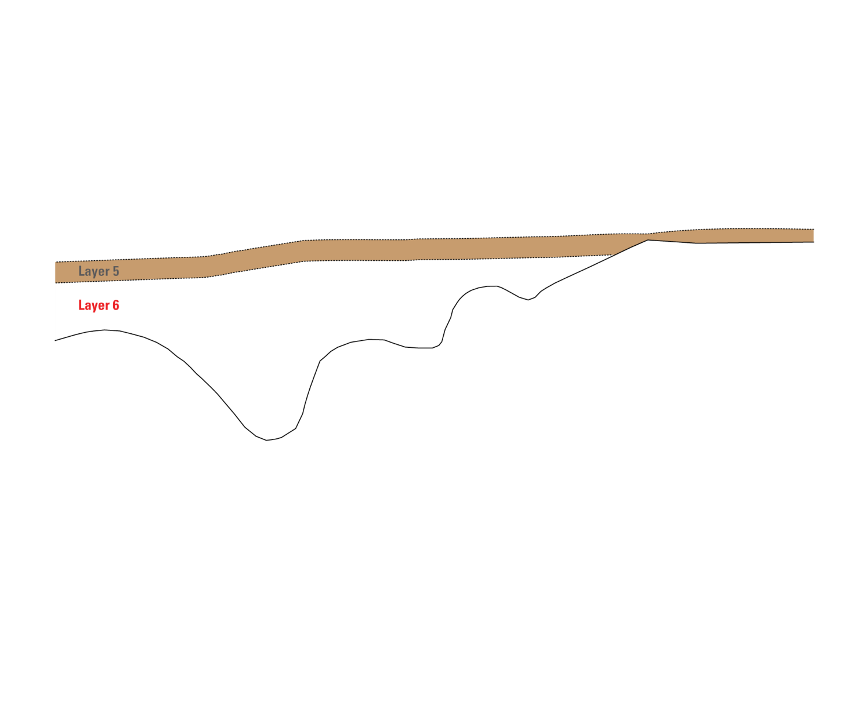
Notes:
-The finite-difference grid is extended into the vertical dimension using layers of cells. The vertical grid spacing consists of six layers of varying thickness:
-[[NEXT]] Layer 1 is approximately 100 feet thick, and extends down from the water-table;
-[[NEXT]] Layer 2 is 100 feet thick;
-[[NEXT]] Layer 3 is 0 to 100 feet thick;
-[[NEXT]] Layer 4 is 0 to 200 feet thick;
-[[NEXT]] Layer 5 is 0 to 300 feet thick; and
-[[NEXT]] Layer 6 is 0 to about thirty-three hundred feet thick and extends down to the base of the aquifer.

Slide 9
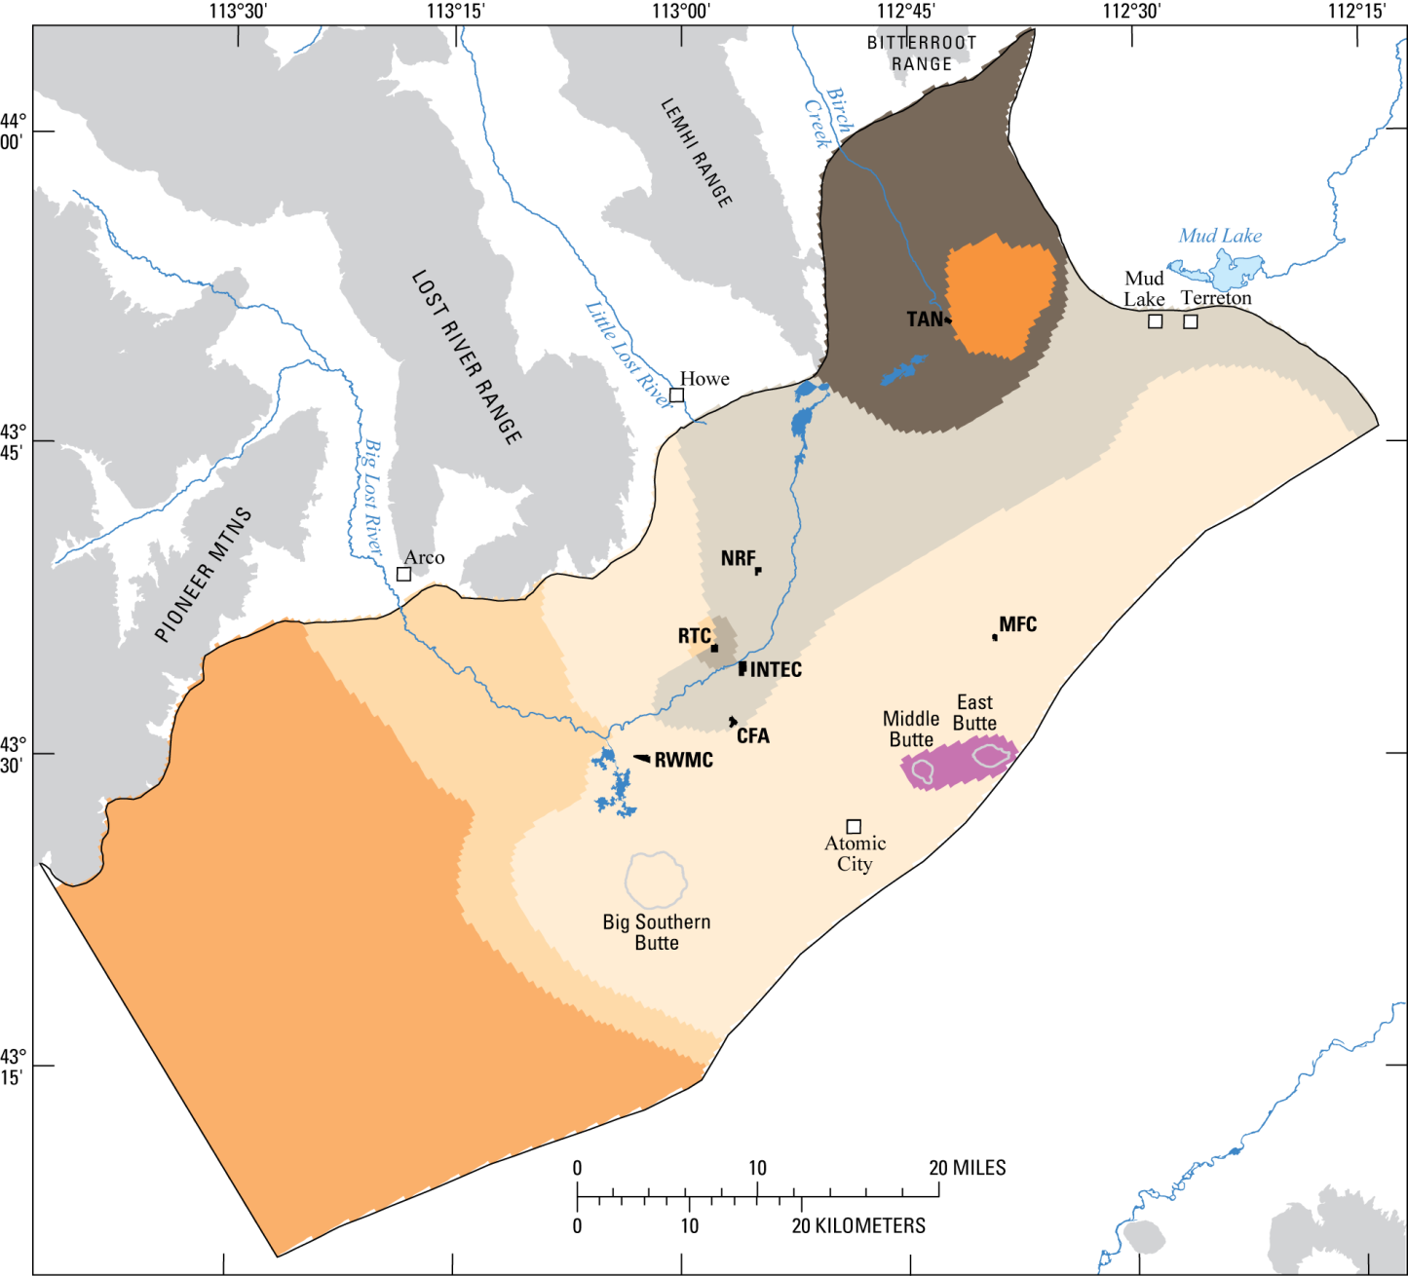
L1
Notes:
-The hydrogeologic zones within layer 3 are shown here and should provide you with a sense of how zones were allocated within a model layer.
-Inactive cells are represented with hatching and show, in this case, the encroachment of older rocks from the Lost River Range.
-Note that most of the more transmissive zones are captured in the top three layers.

Slide 10
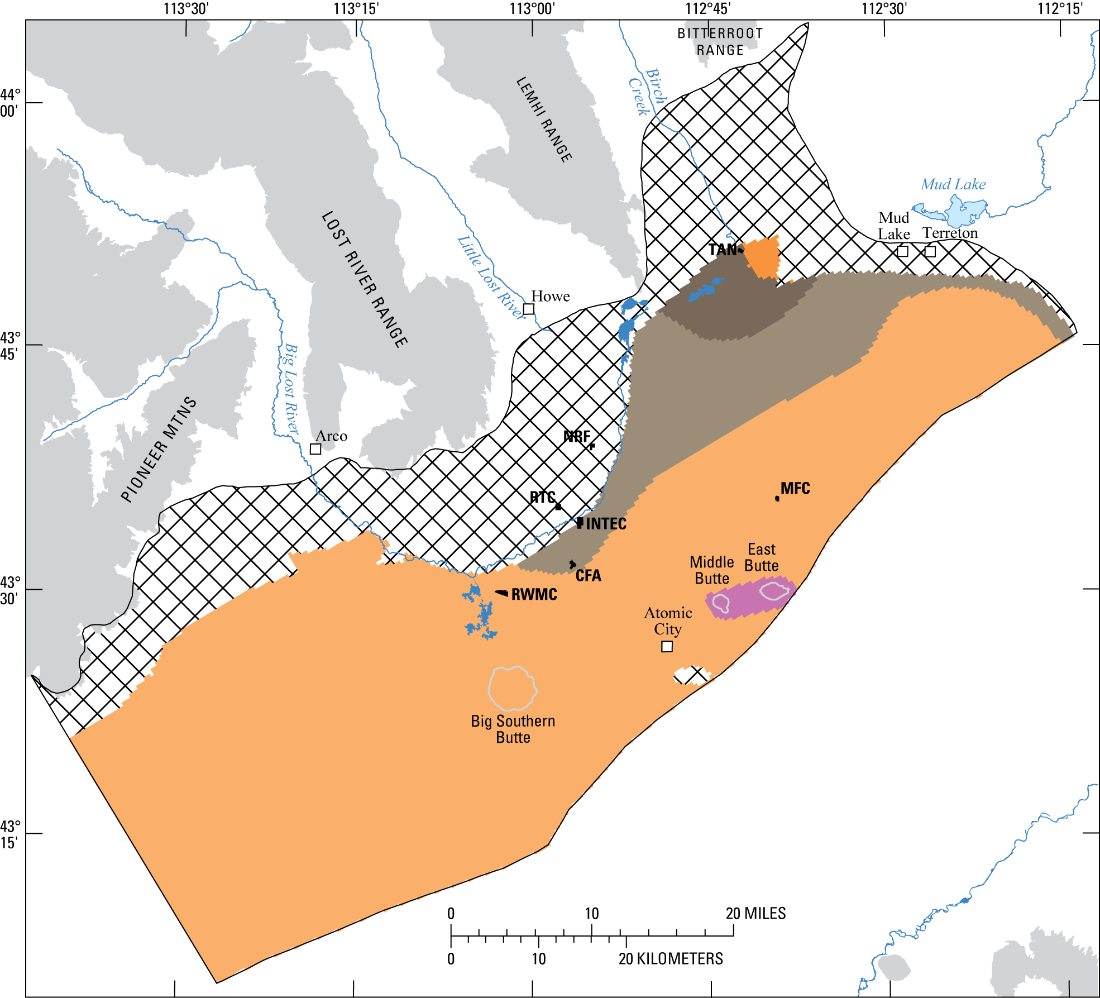
L6
Notes:
-The hydrogeologic zones within layer 3 are shown here and should provide you with a sense of how zones were allocated within a model layer.
-Inactive cells are represented with hatching and show, in this case, the encroachment of older rocks from the Lost River Range.
-Note that most of the more transmissive zones are captured in the top three layers.

Slide 11
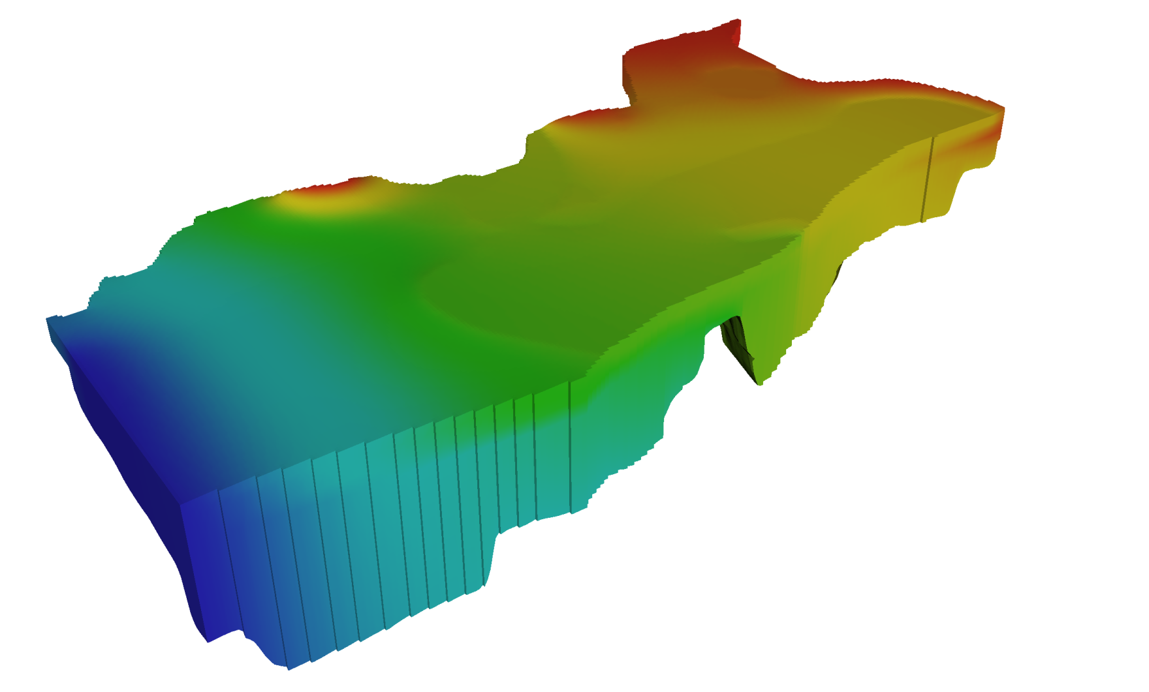
Notes:
Solving the partial differential equation governing groundwater flow gives the hydraulic head (head) at every cell in the model domain. Direction and rate of water flow depend on differences in hydraulic head between different points in the model domain.
Are these model-derived estimates of groundwater movement consistent with results from previous and current studies on water chemistry type?

Slide 12
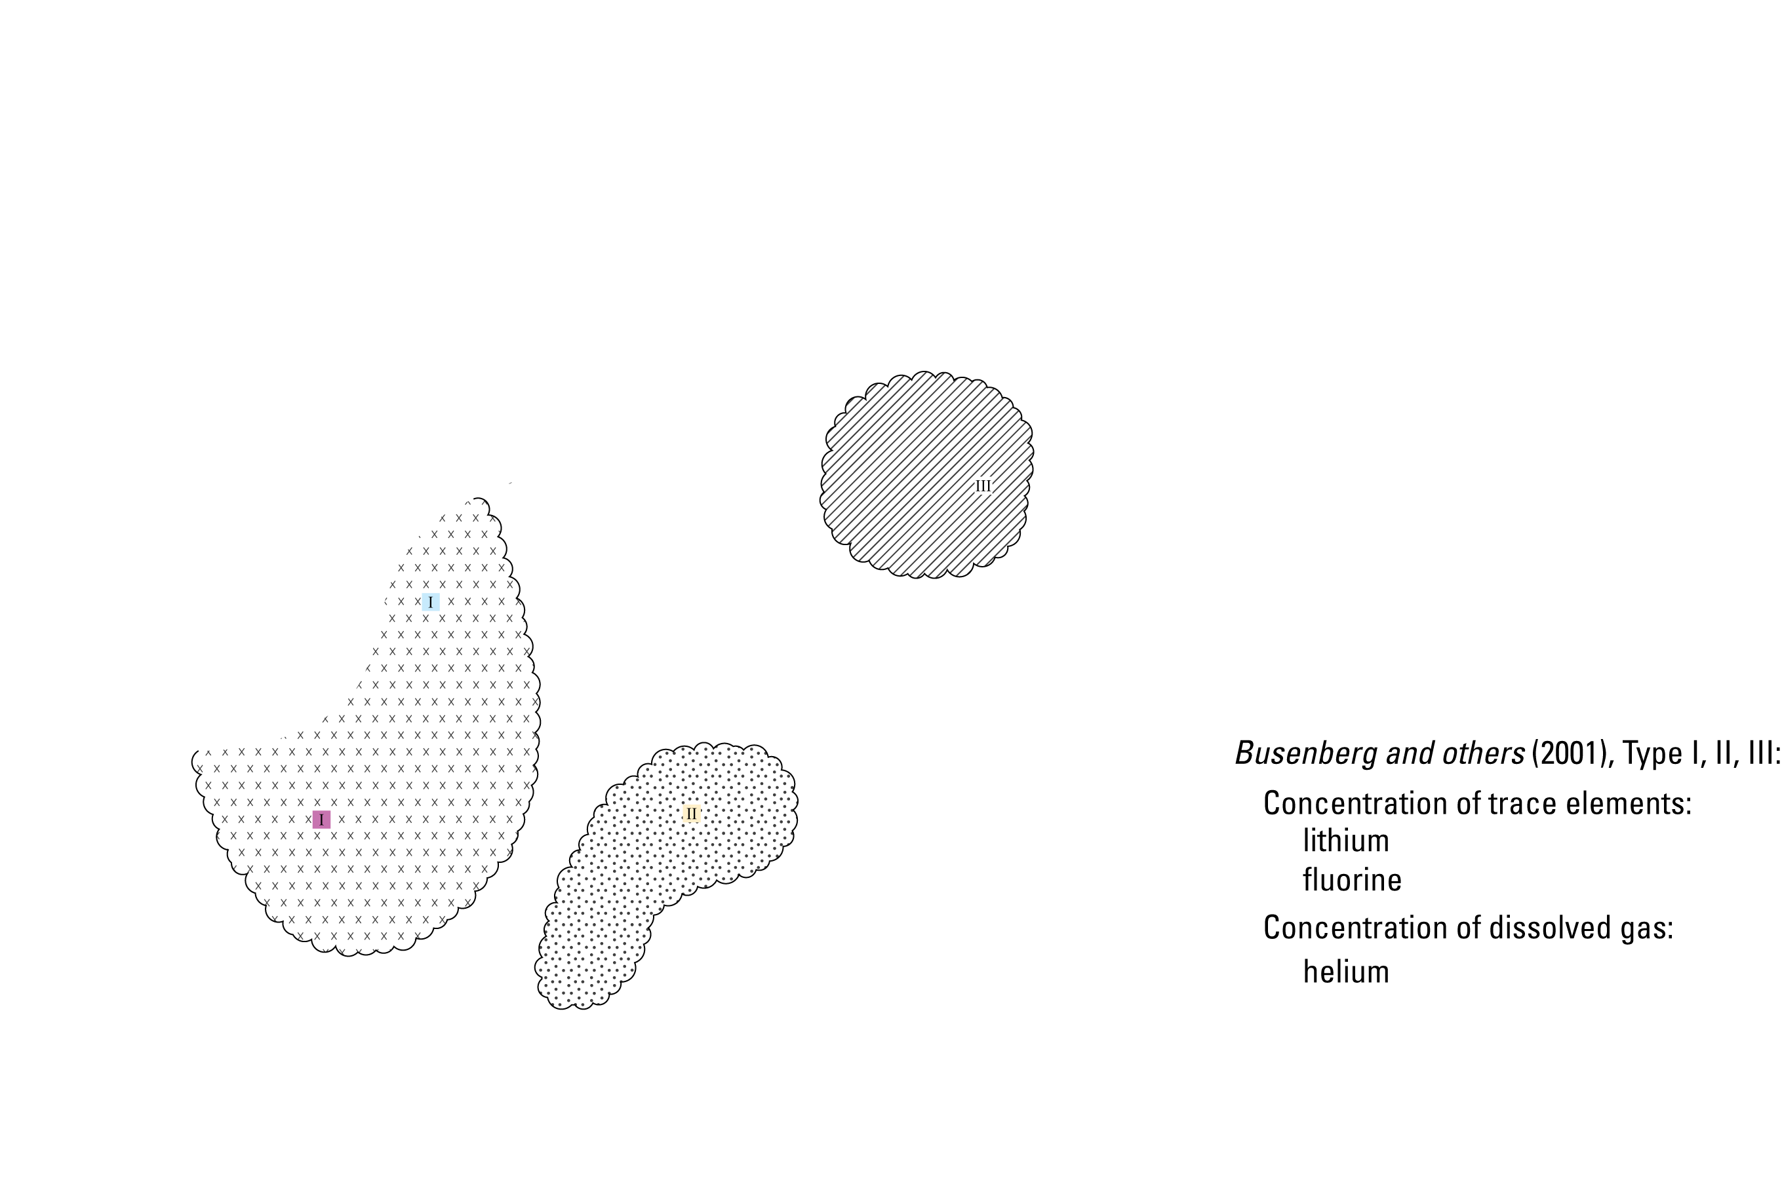
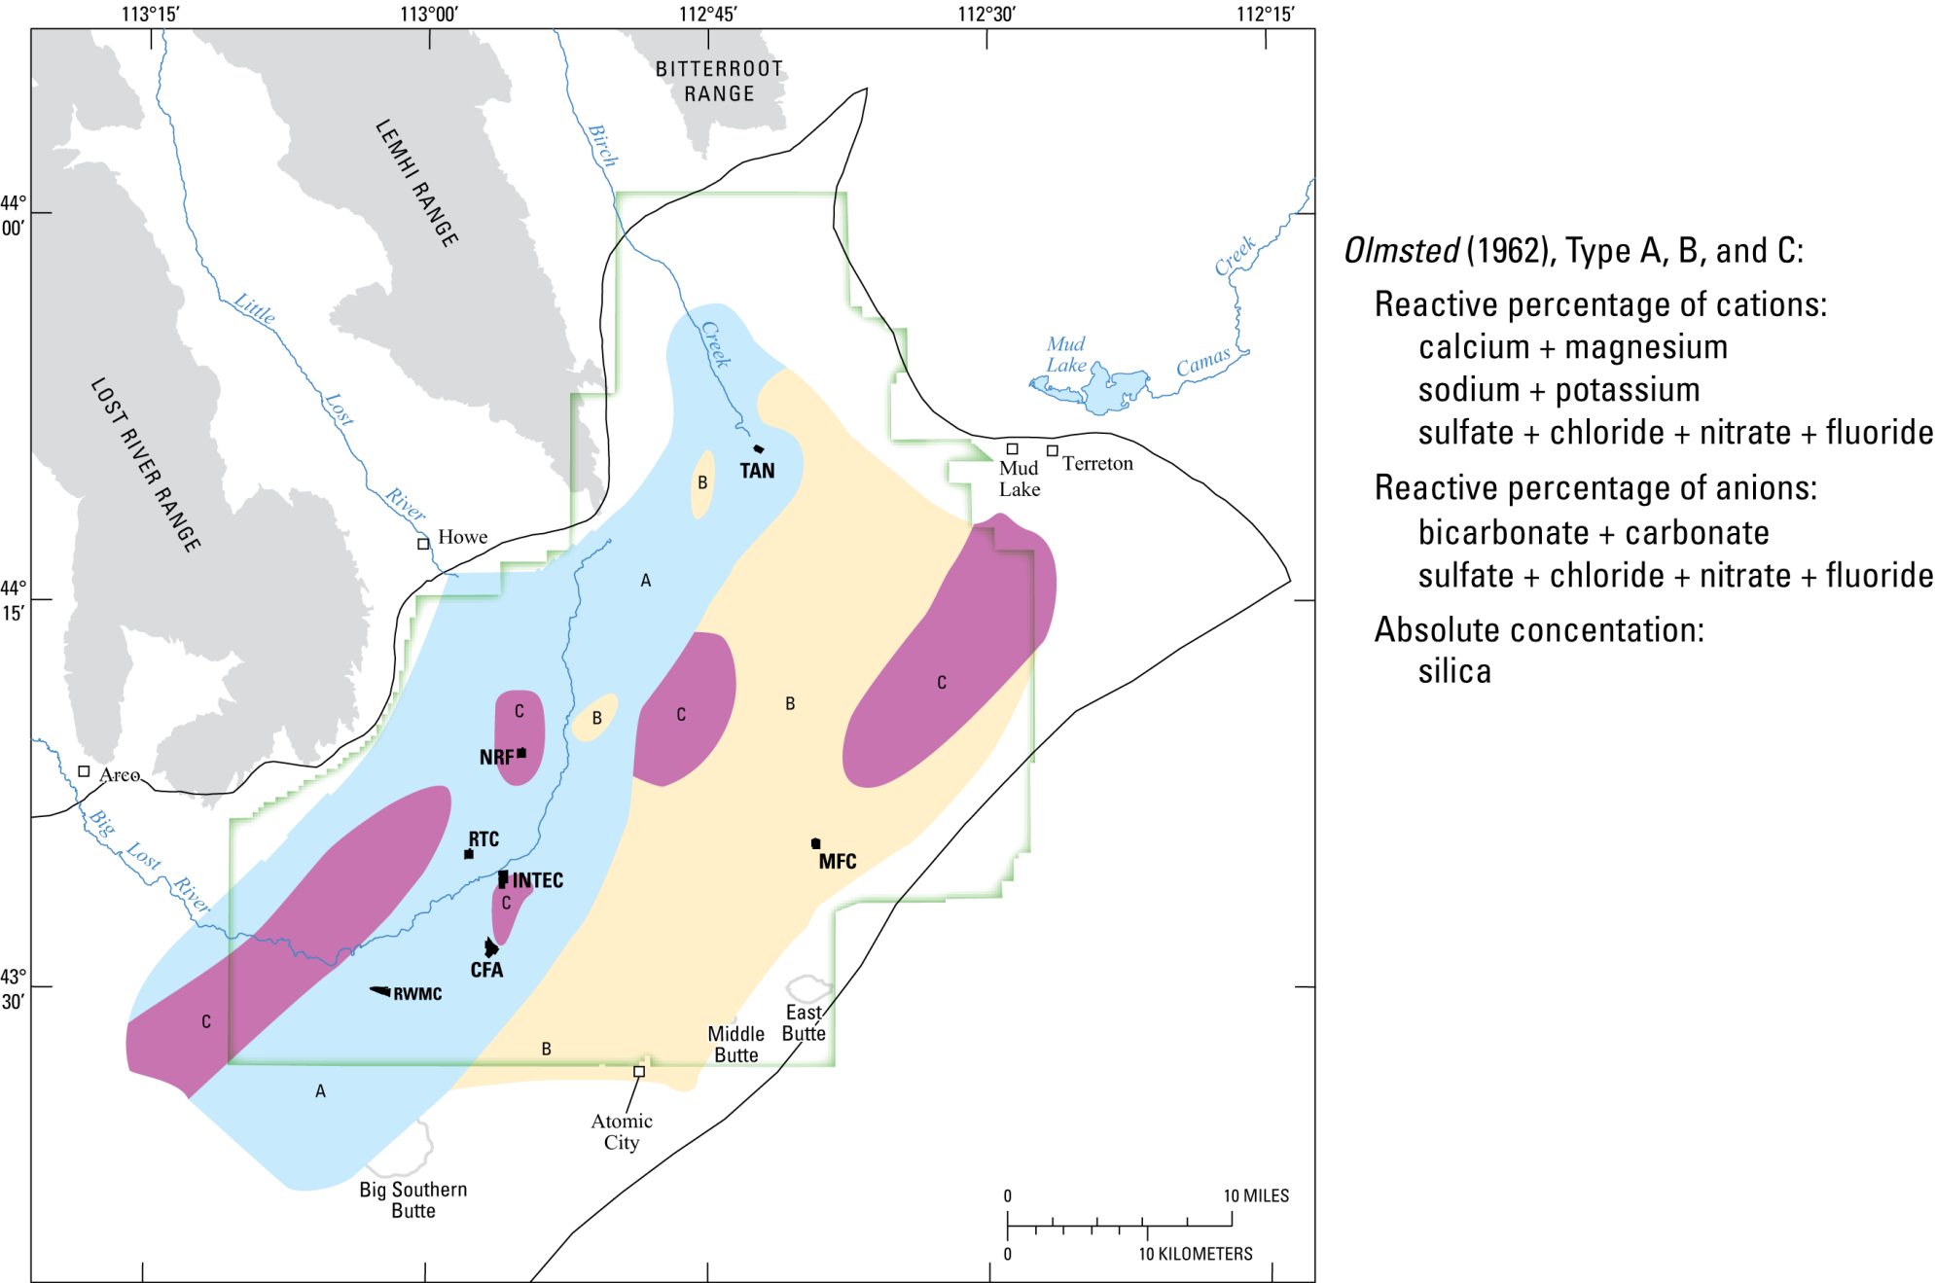

Notes:
Olmsted (1962) defined and mapped the distribution of three principle water types (Type A, B, C) in the model area based on the cationic and anionic compositions of water from 96 wells that penetrate the upper 200 ft of the aquifer. Type A water originates from alluvial aquifer underflow (i.e. tributary valleys); Type B water originates from the basaltic lava flows (i.e. north and east of the model area); Type C water locally occurs in areas contaminated by wastewater disposal and irrigation return flow.
Buesenberg and others (2001) identified three naturally occurring water types (Type I, II, III) based on the concentrations of the trace elements lithium and fluorine, and the dissolved gas helium. Type I water is present mainly in the western part of the INL and is derived from alluvial aquifer underflow (i.e. tributary valleys); Type II water is present mainly in the southeastern part of the INL and represents a binary mixture of very old regional water and young water from locally derived rapid focused recharge; Type III water is present mainly in the northeastern part of the INL and is derived from regional aquifer underflow that is mixed with rapid focused recharge and agricultural return flow.

Slide 13
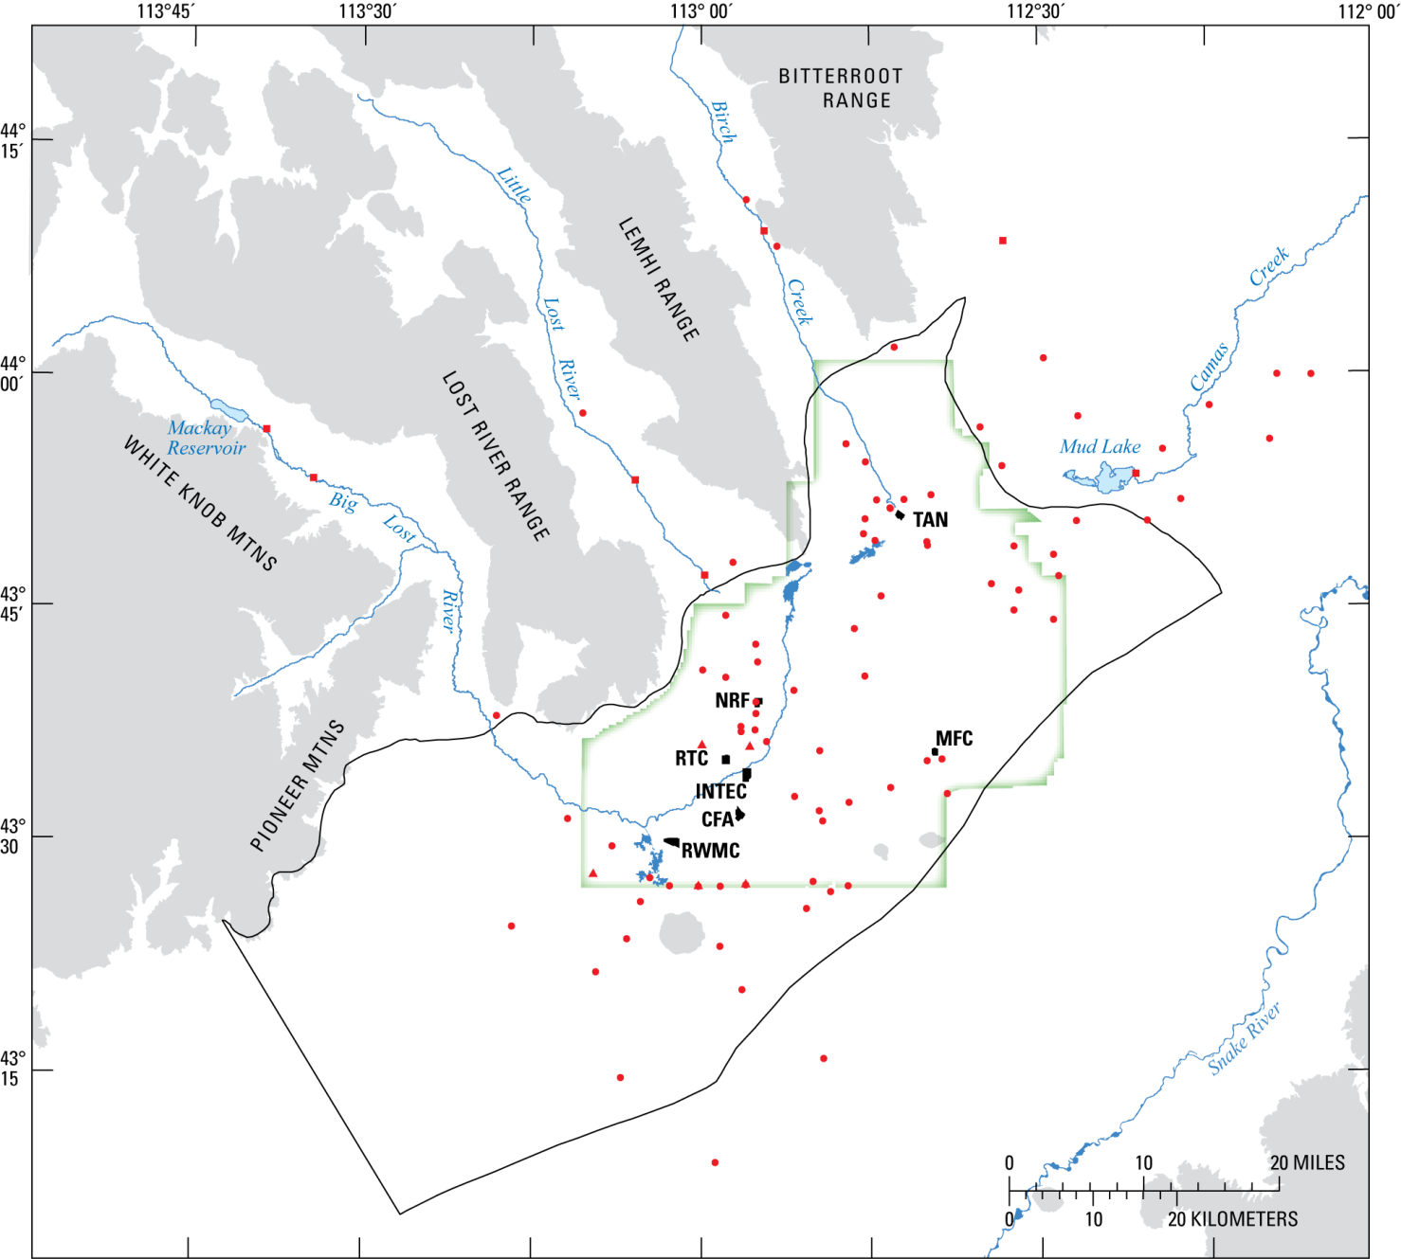
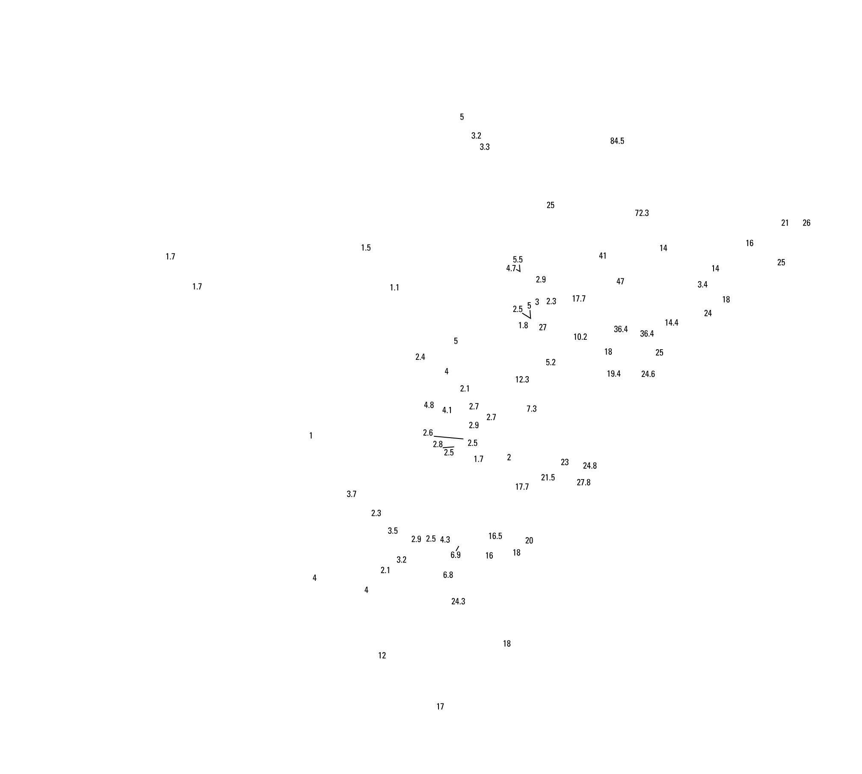
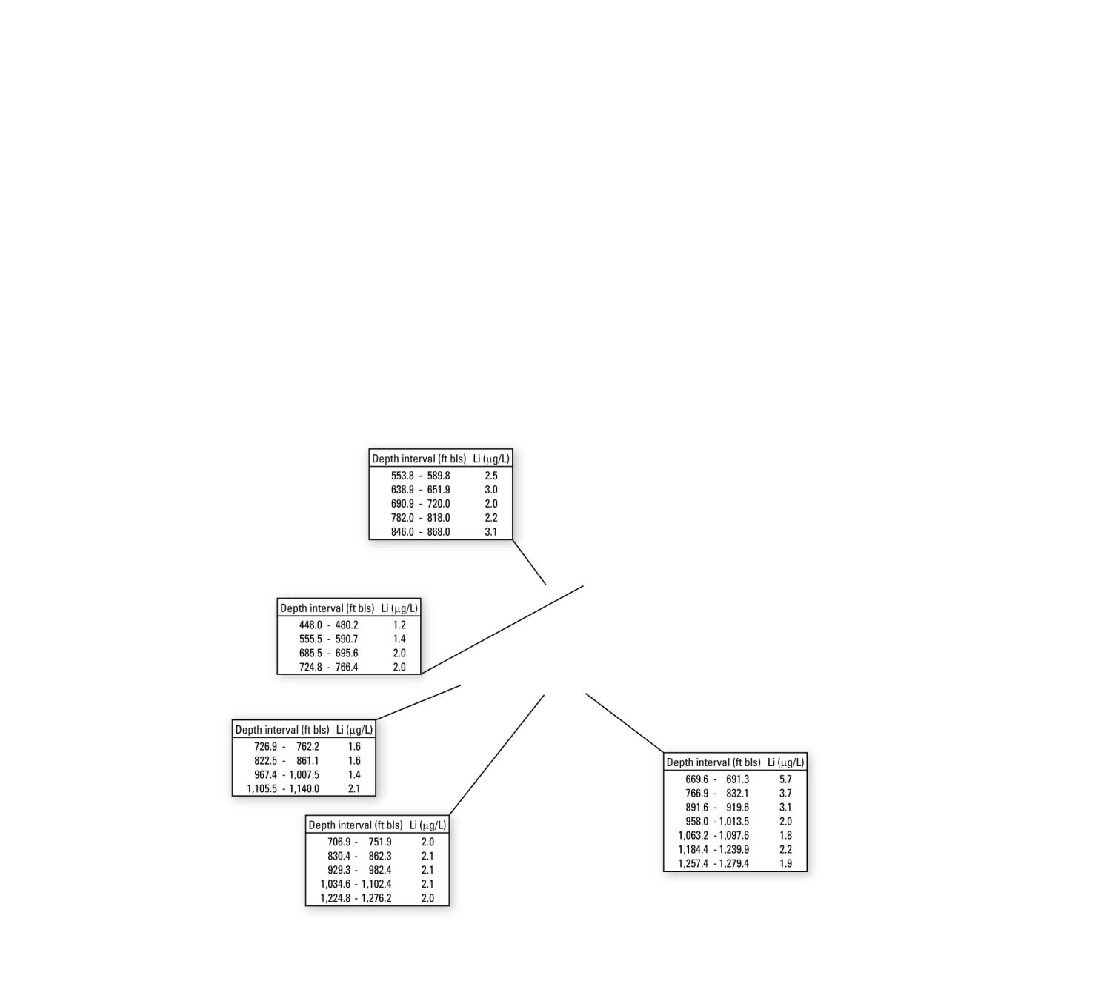


Notes:
In this study, the trace elements lithium (Li) and boron (B) were used to classify two different water types.
Concentrations of Li and B in micrograms per liter from 131 sampling sites. Concentrations of B were not available at every site.

Slide 14
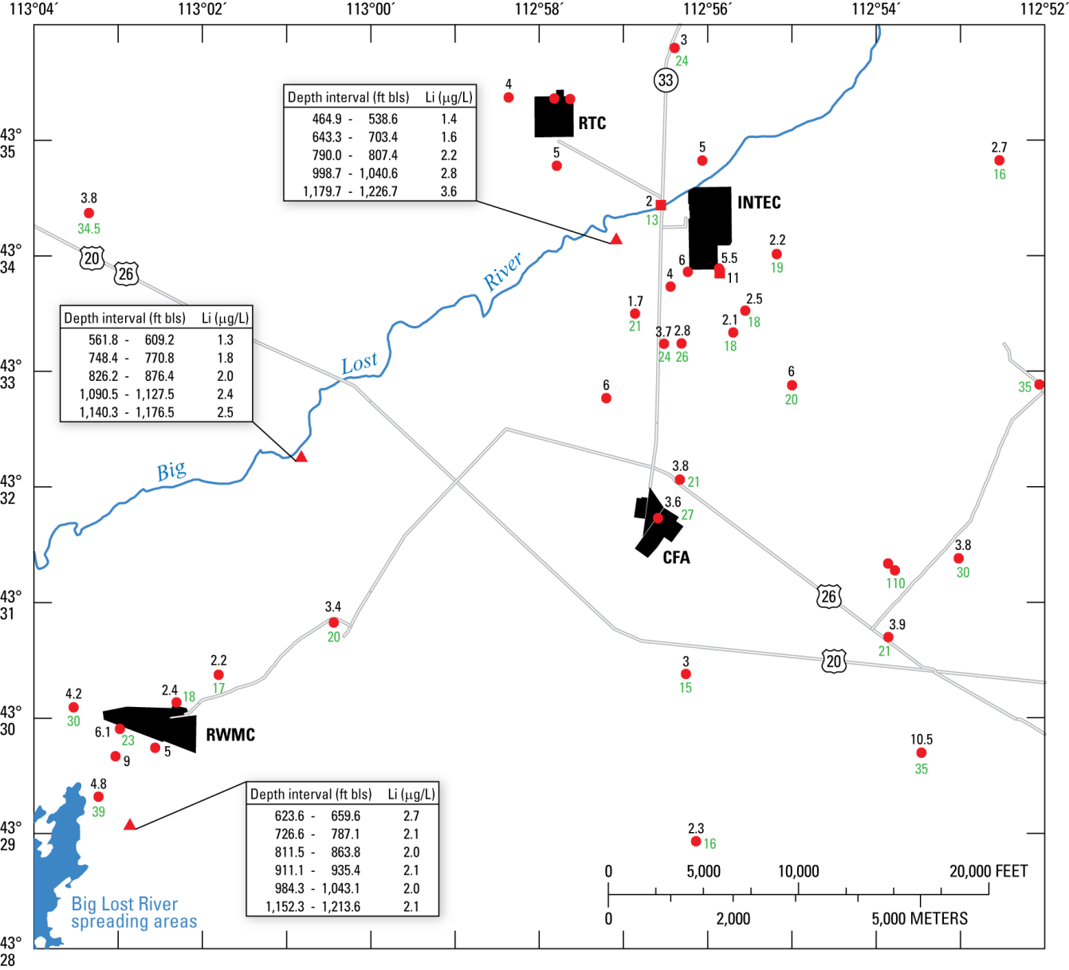

Slide 15
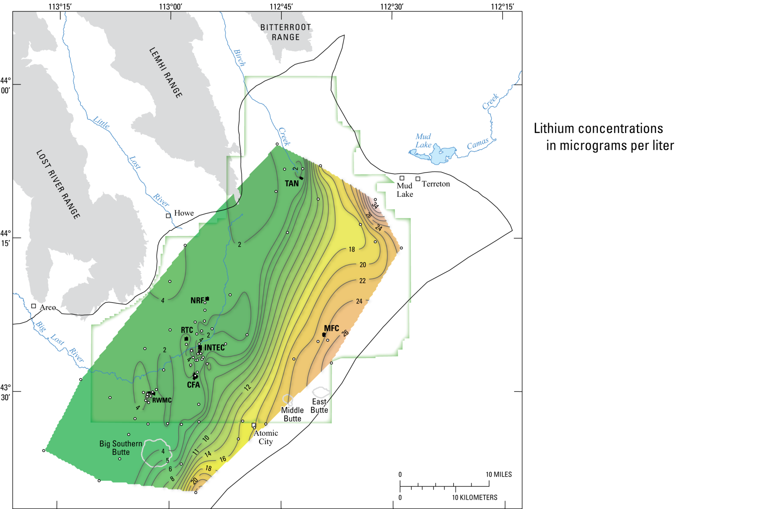
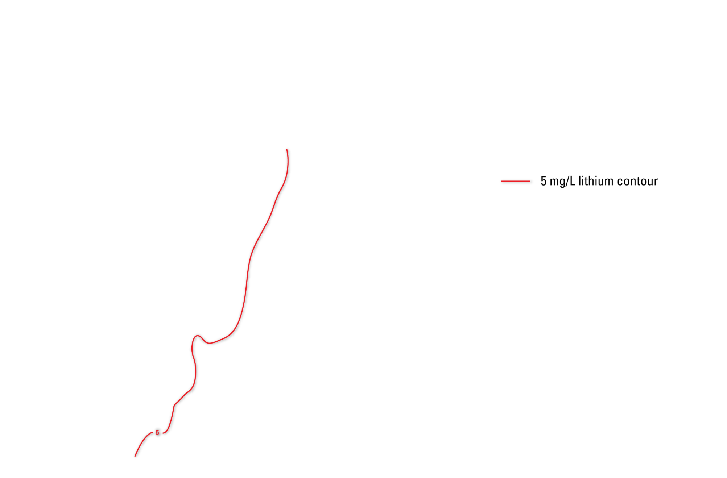
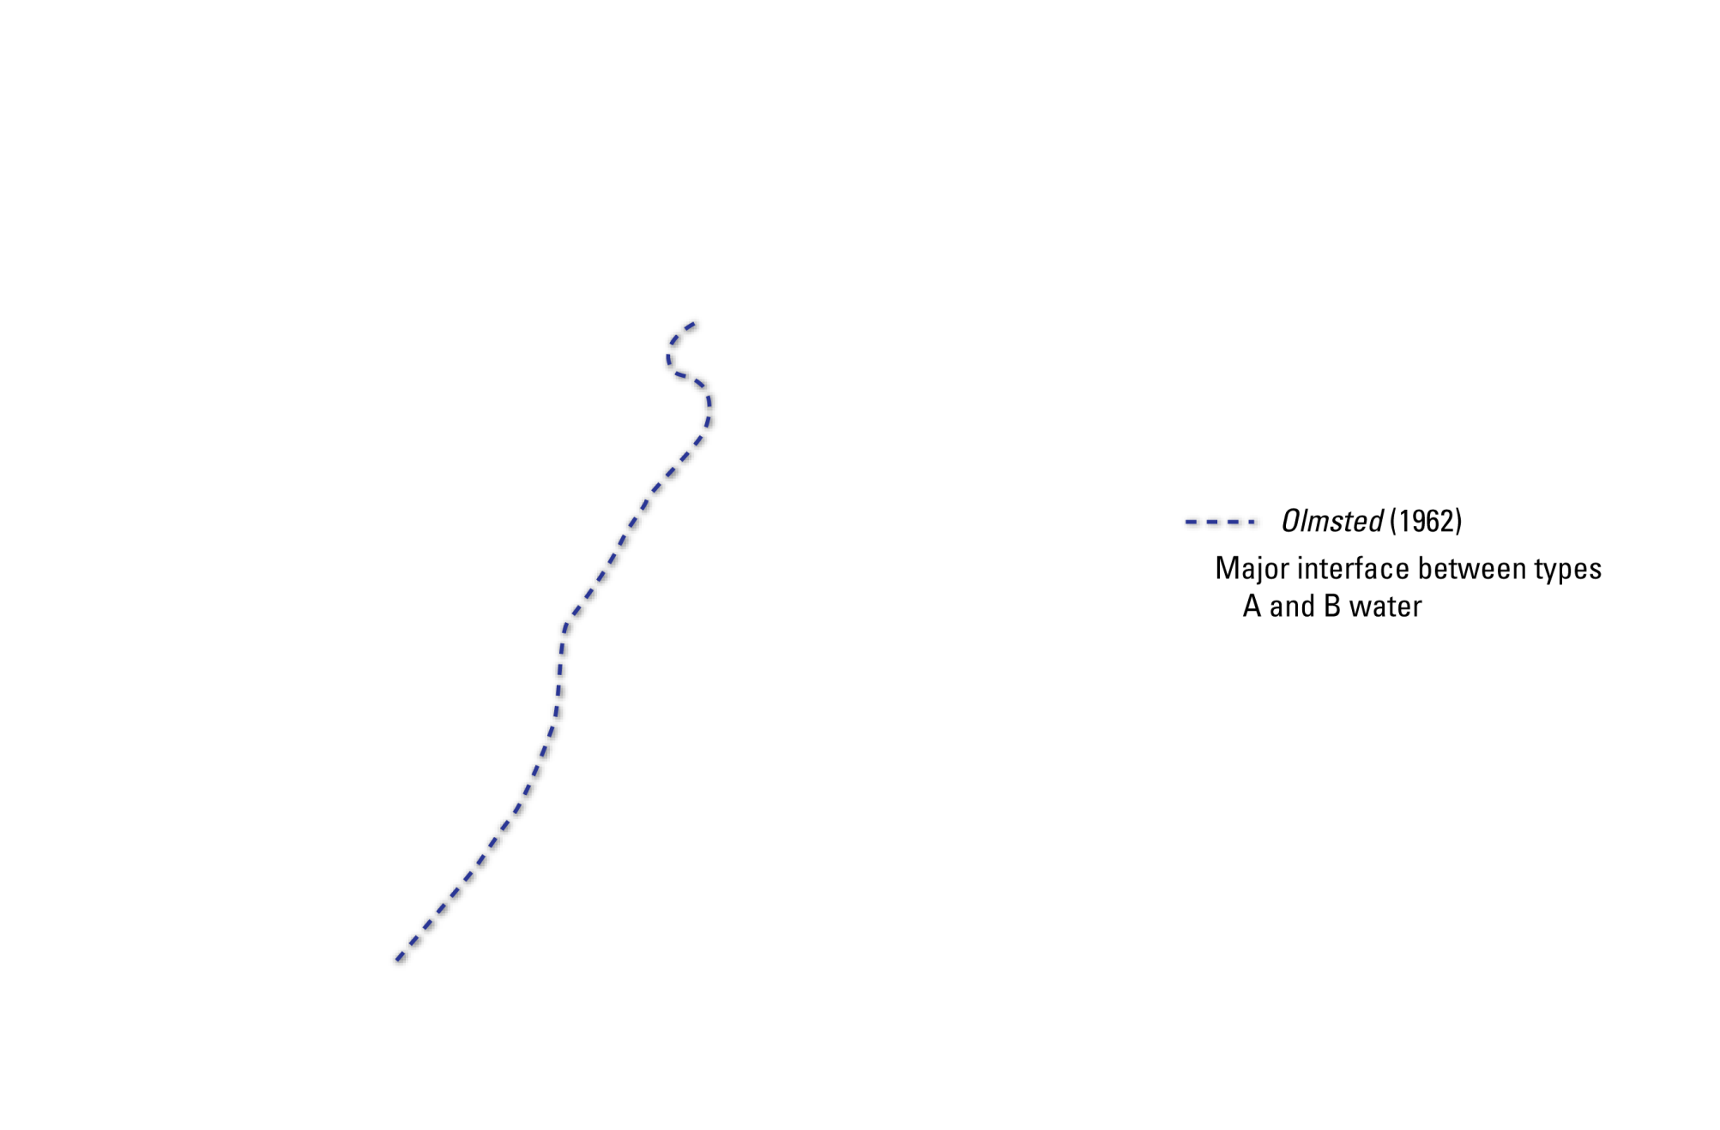

Slide 16
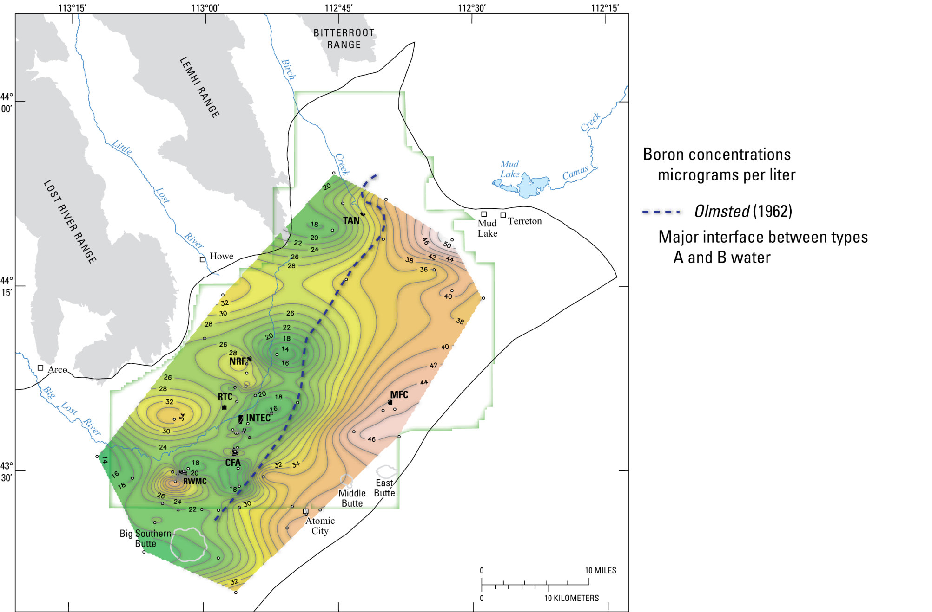

Slide 17
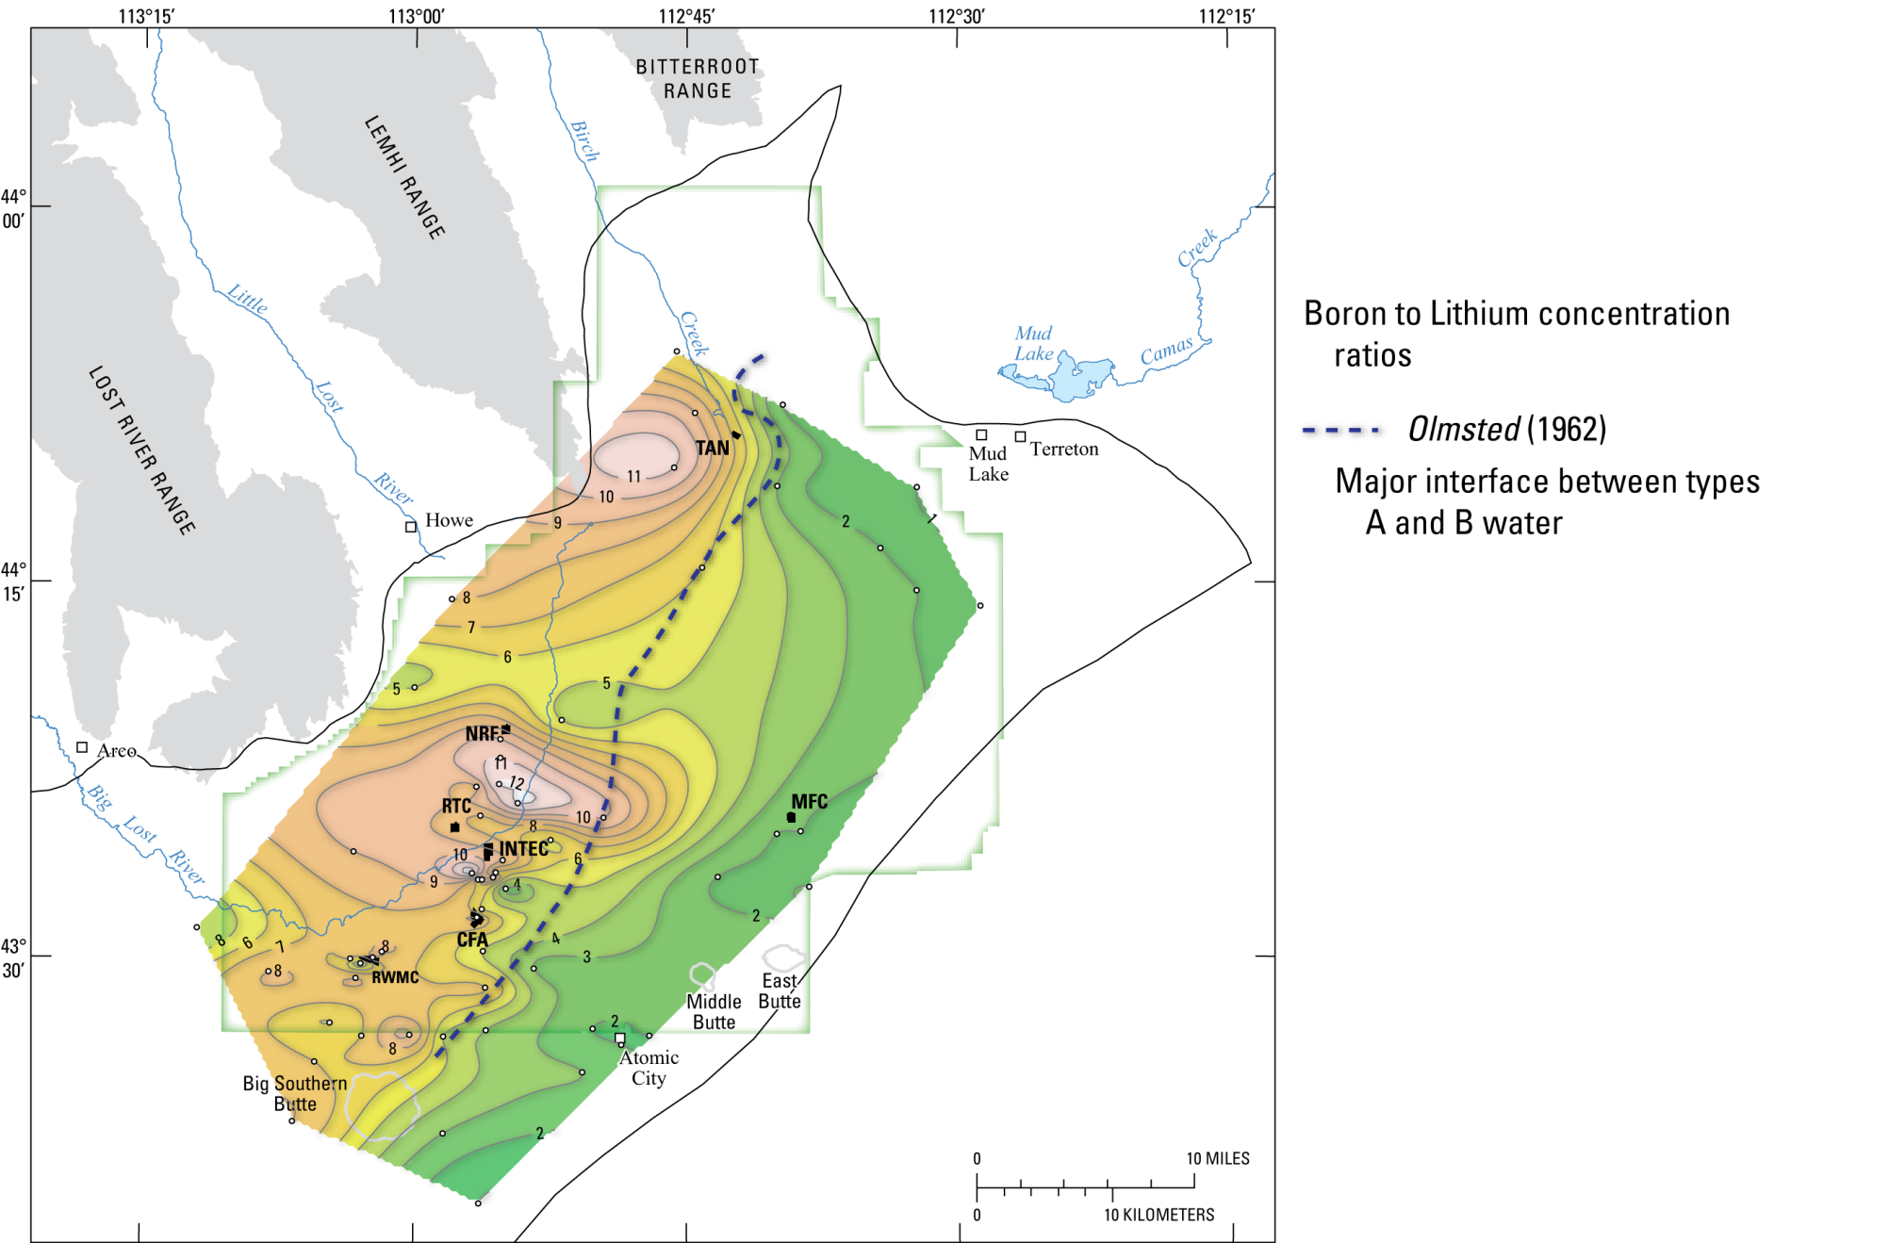

Slide 18
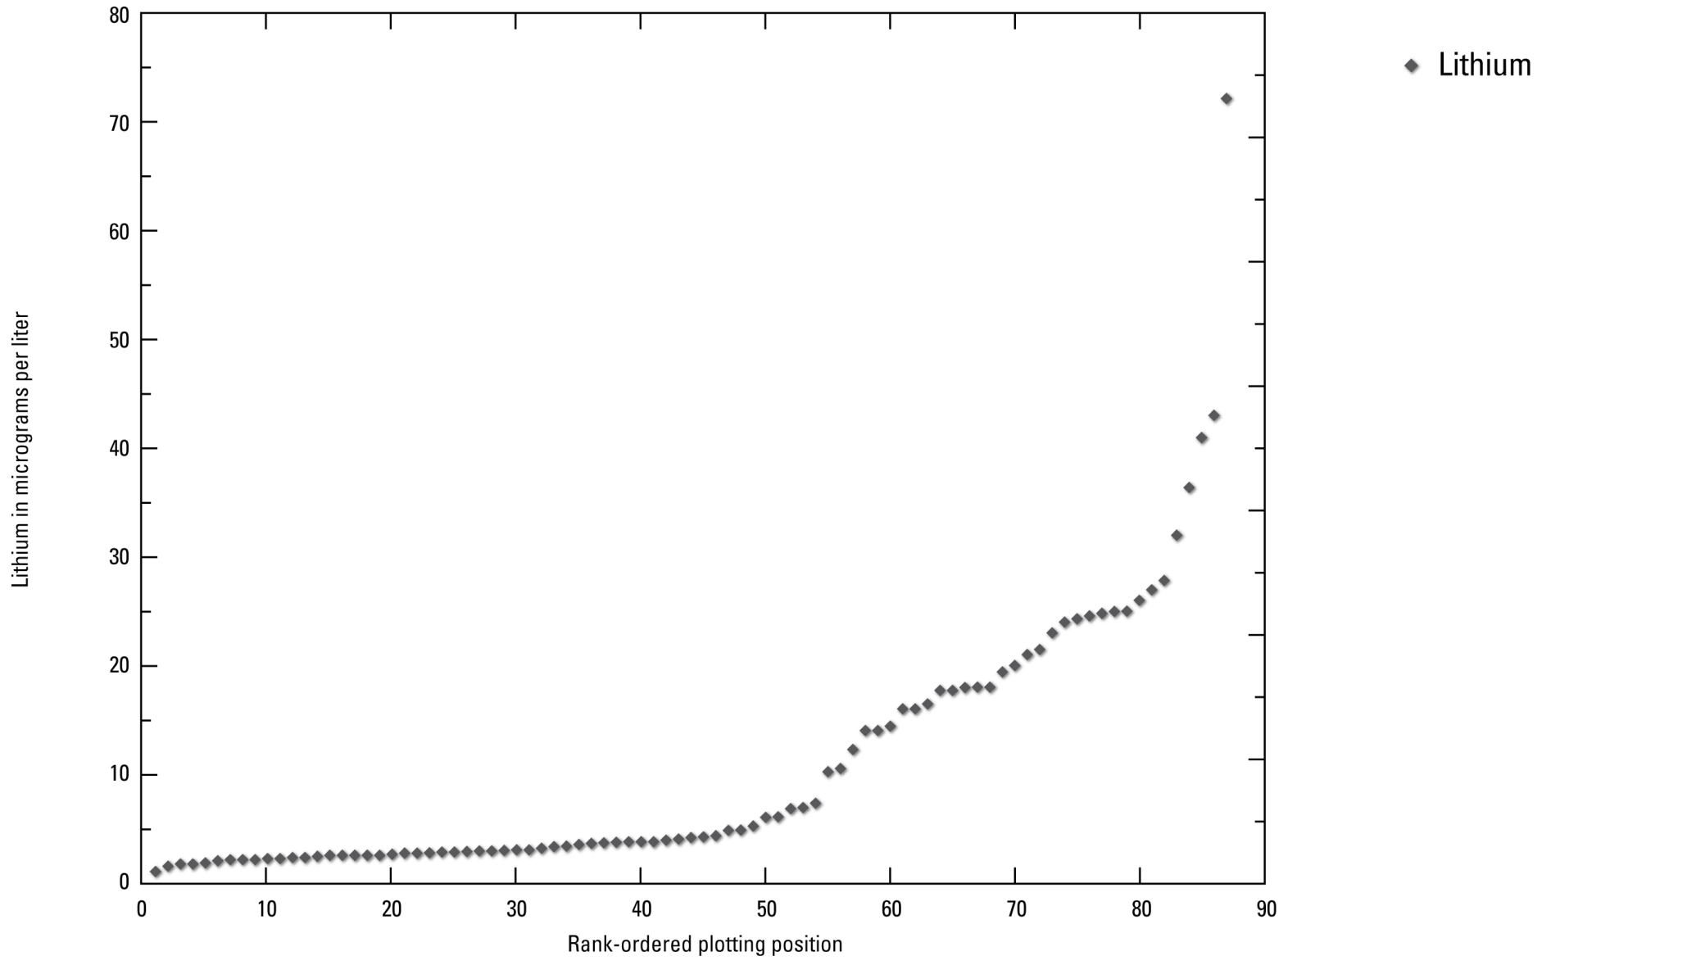
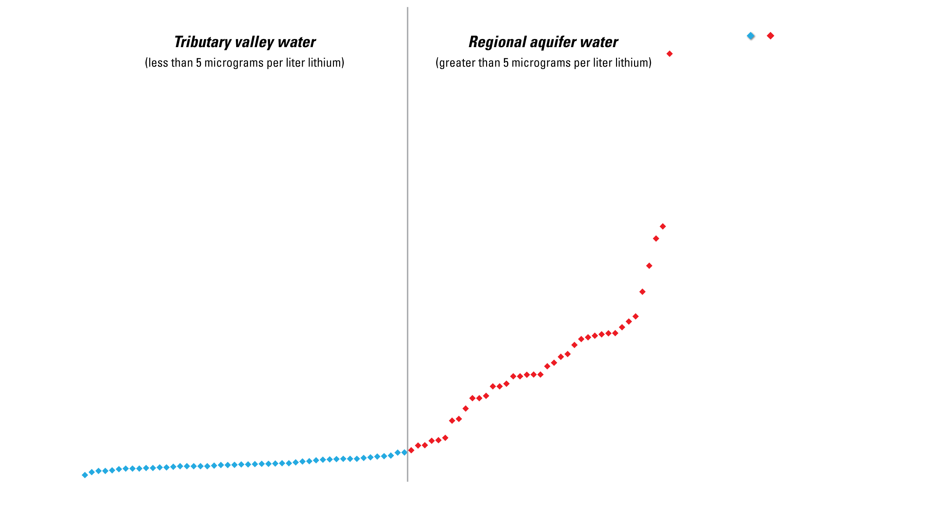

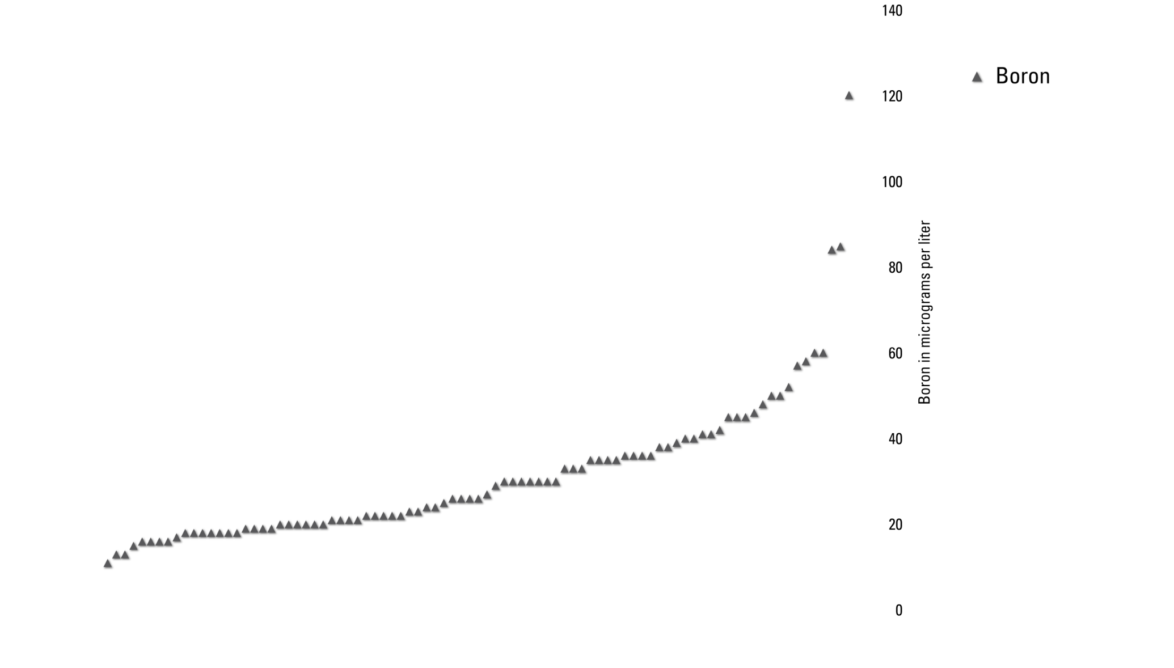
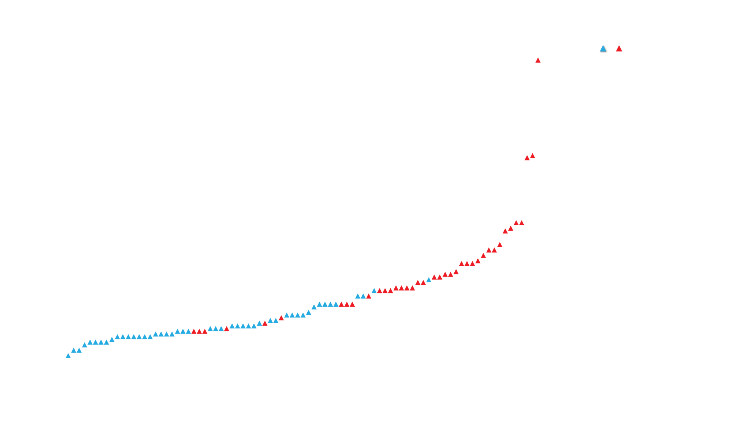
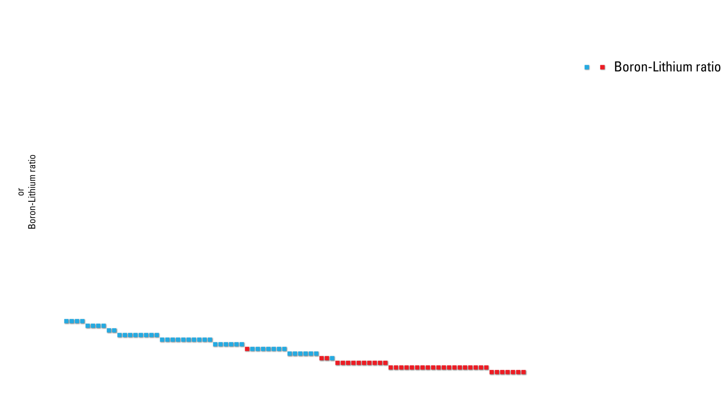

Slide 19
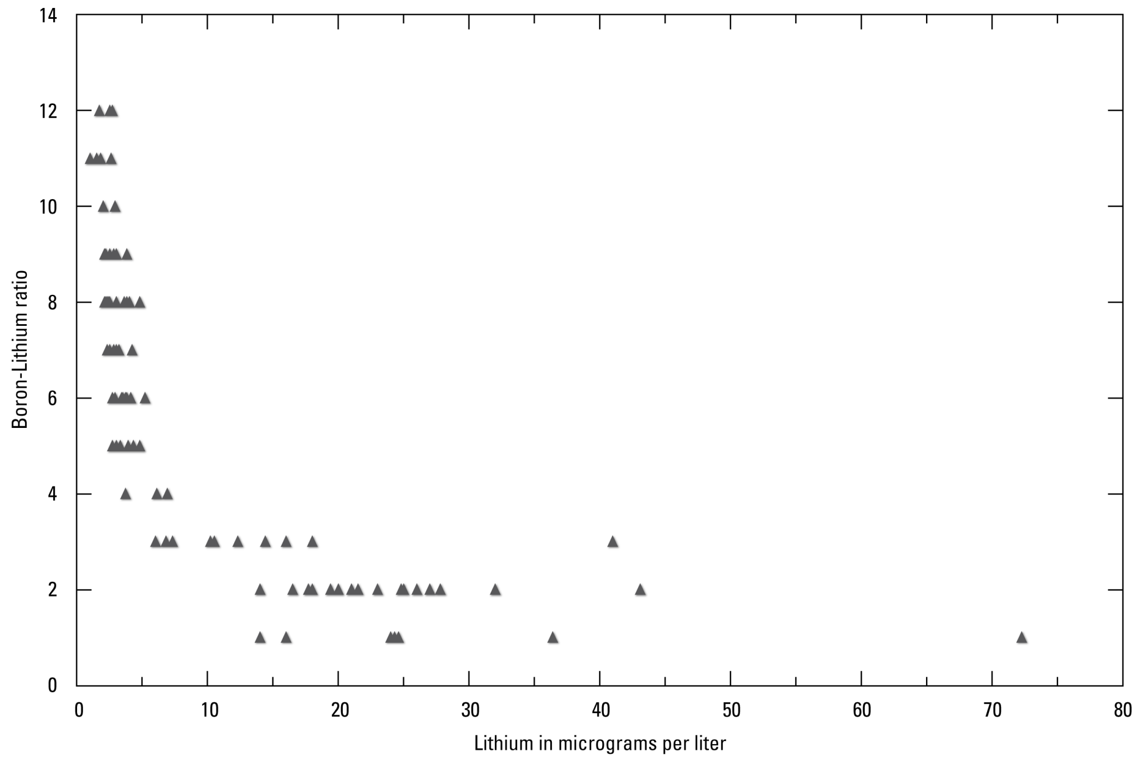

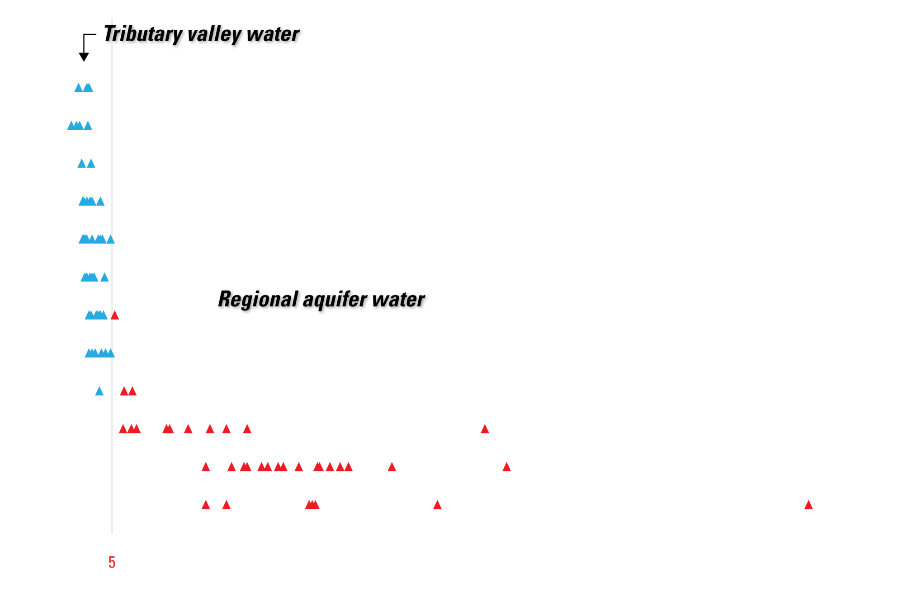
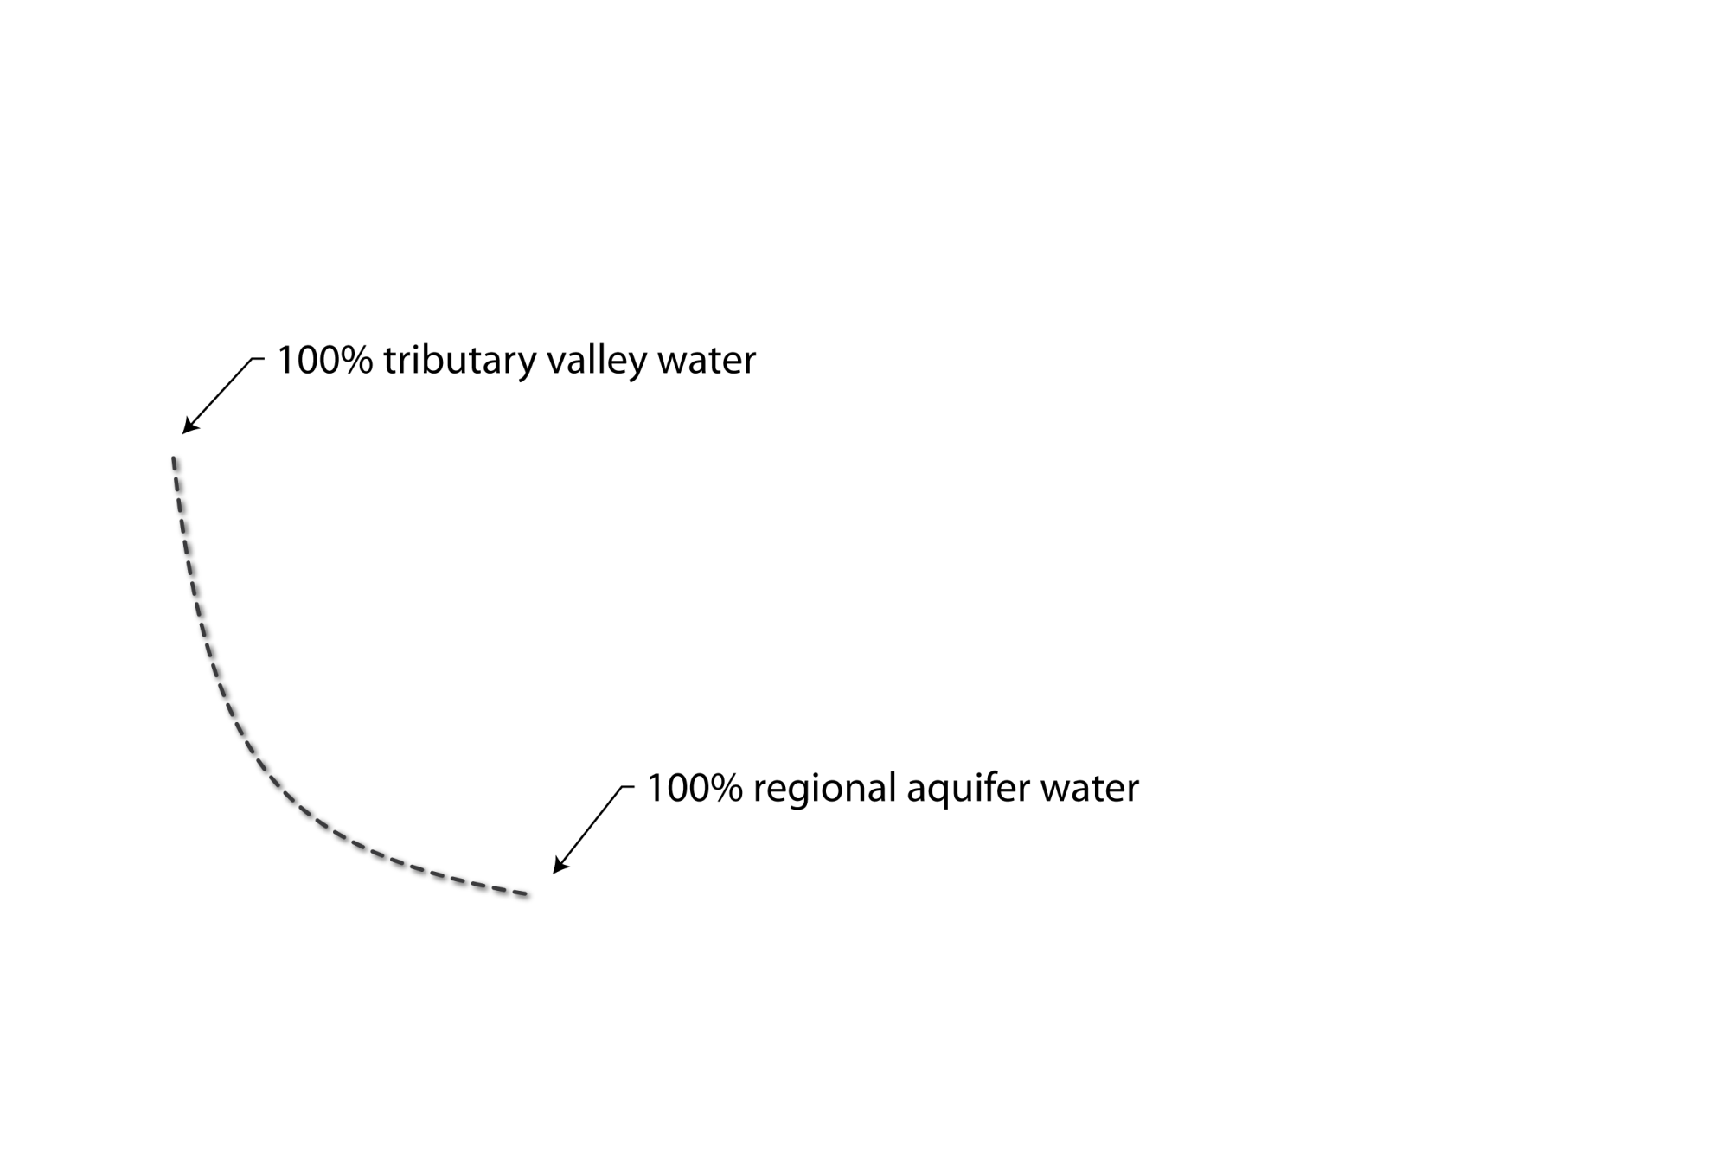


Slide 20
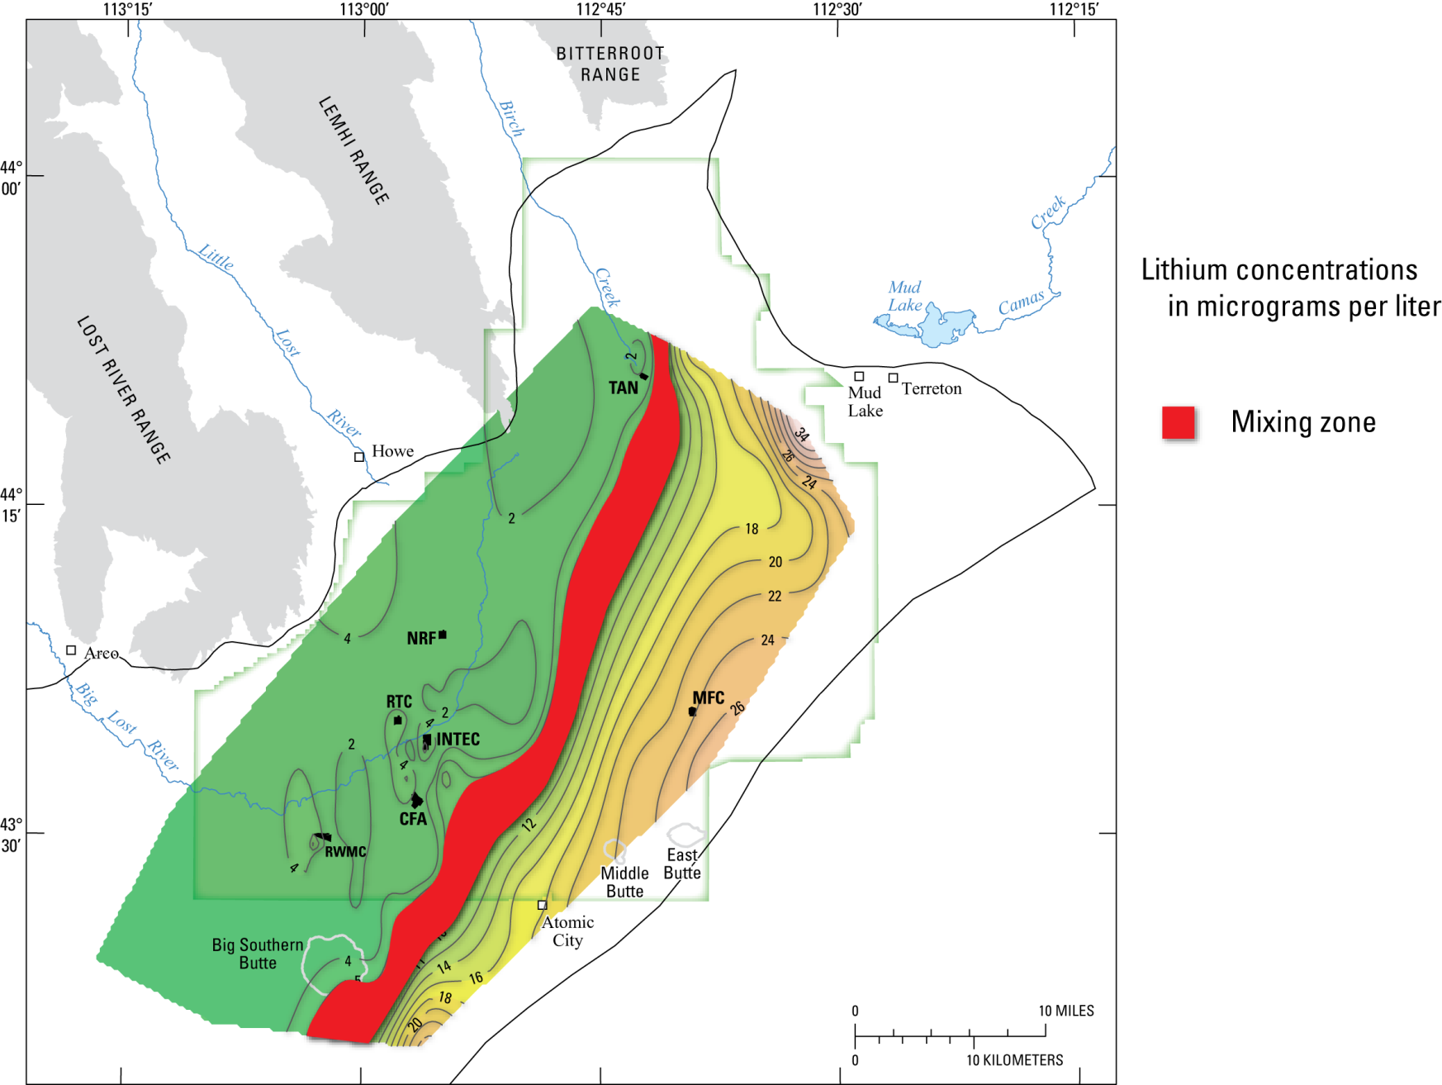

Slide 21
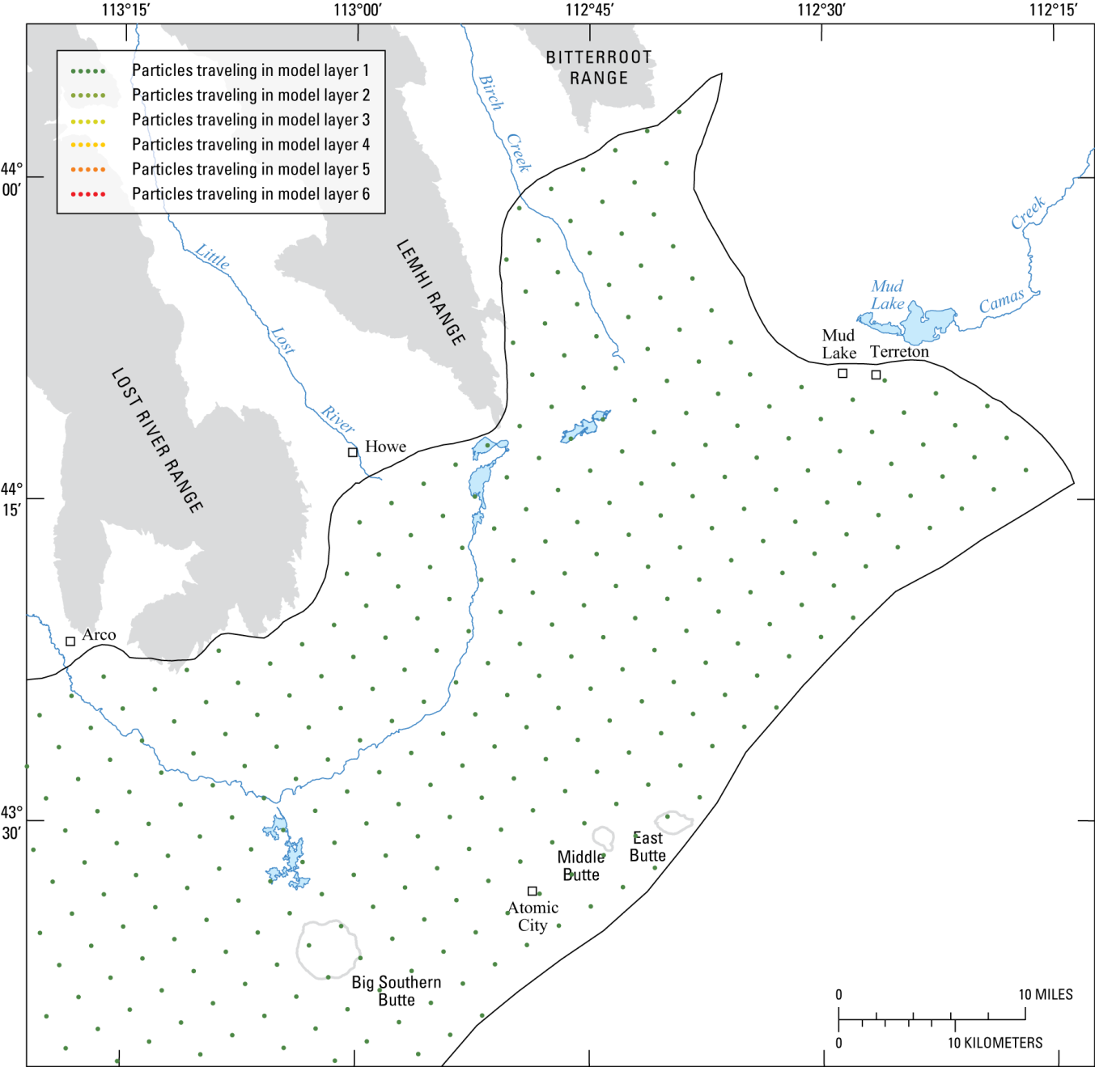
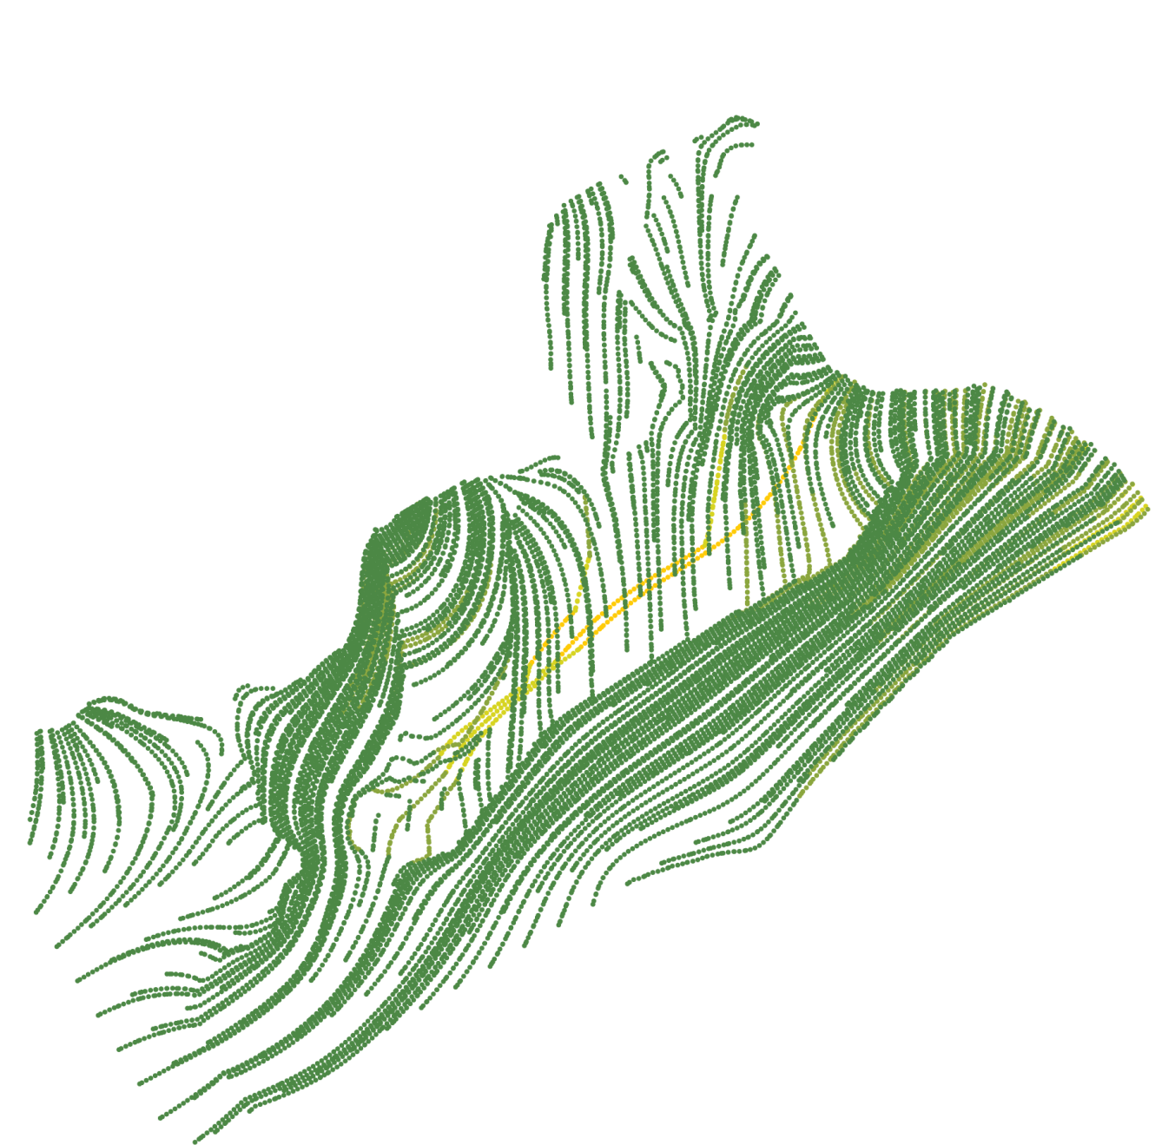


L1

Slide 22
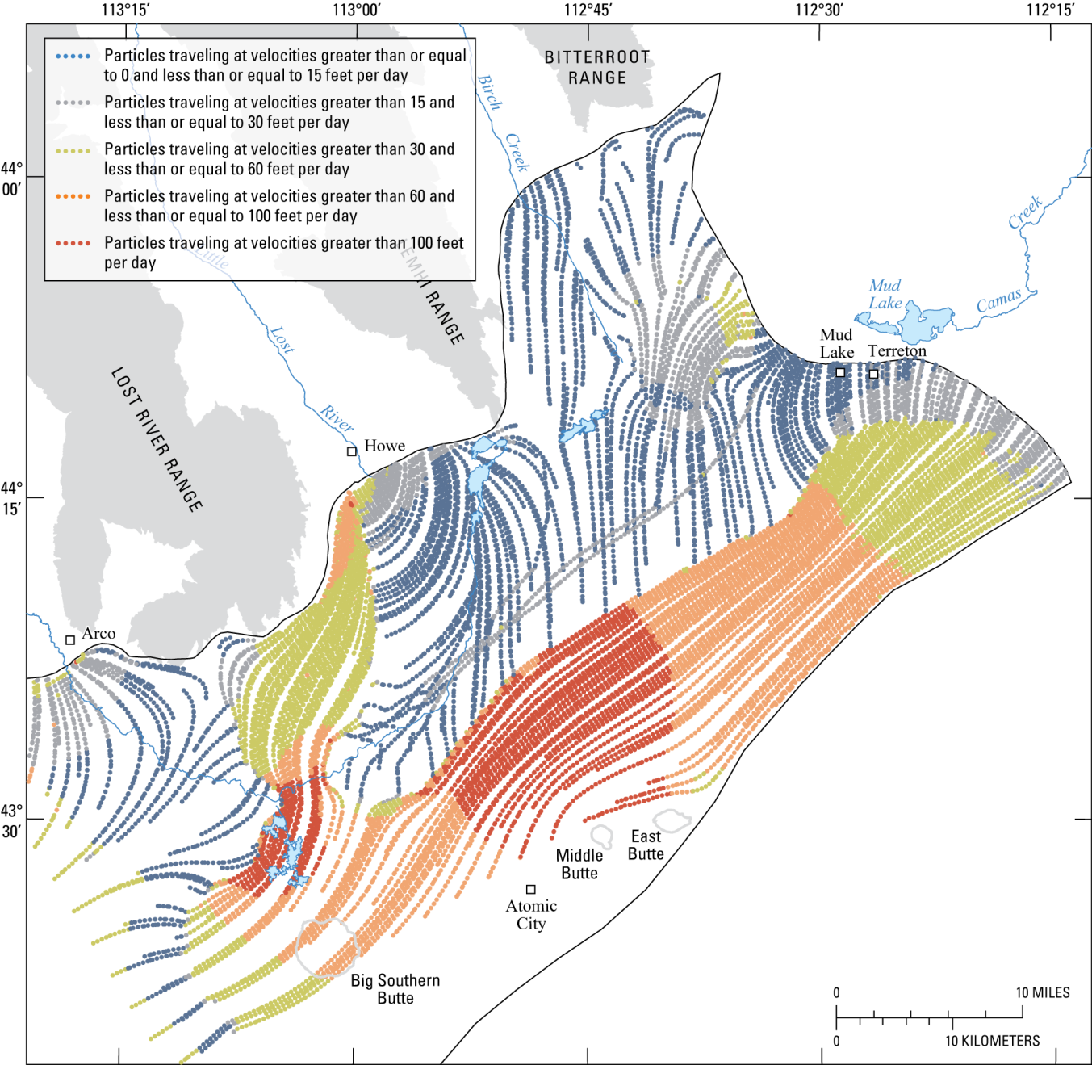


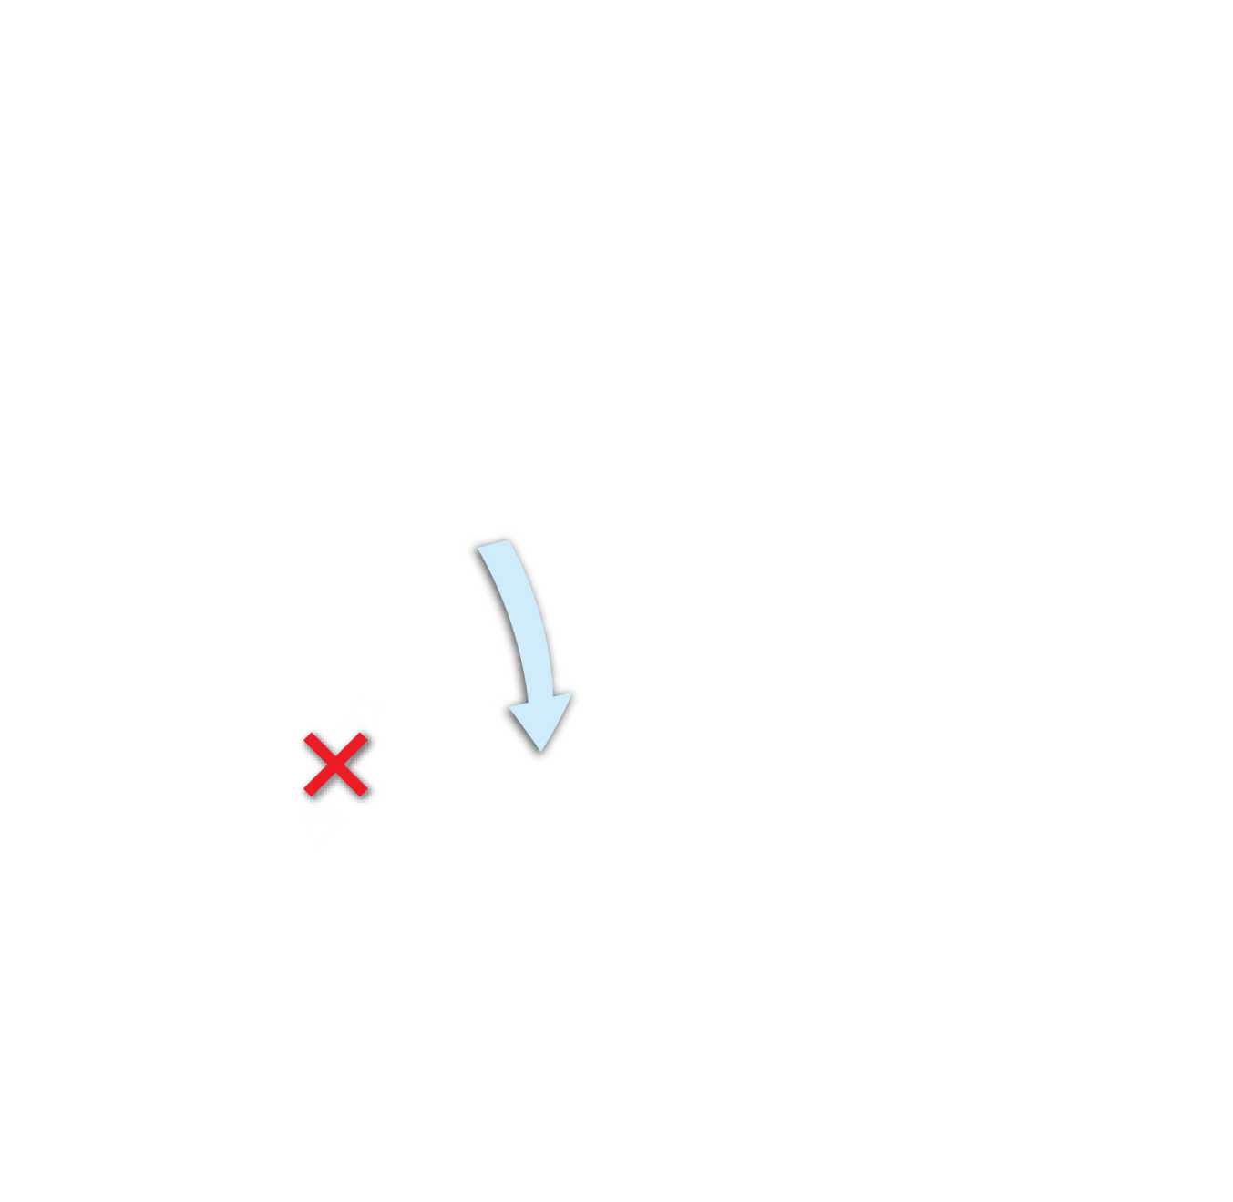
L1

Slide 23


L1

Slide 24

L6

Slide 25



Slide 26





Slide 27


Slide 28




Slide 29



Slide 30


Slide 31



Slide 32


Slide 34








